Slide 1

Using HTTP Client to CONSUME API’s in .Net 6
Sit Dolor Amet

Slide 2
MOVIE’S api

Slide 3
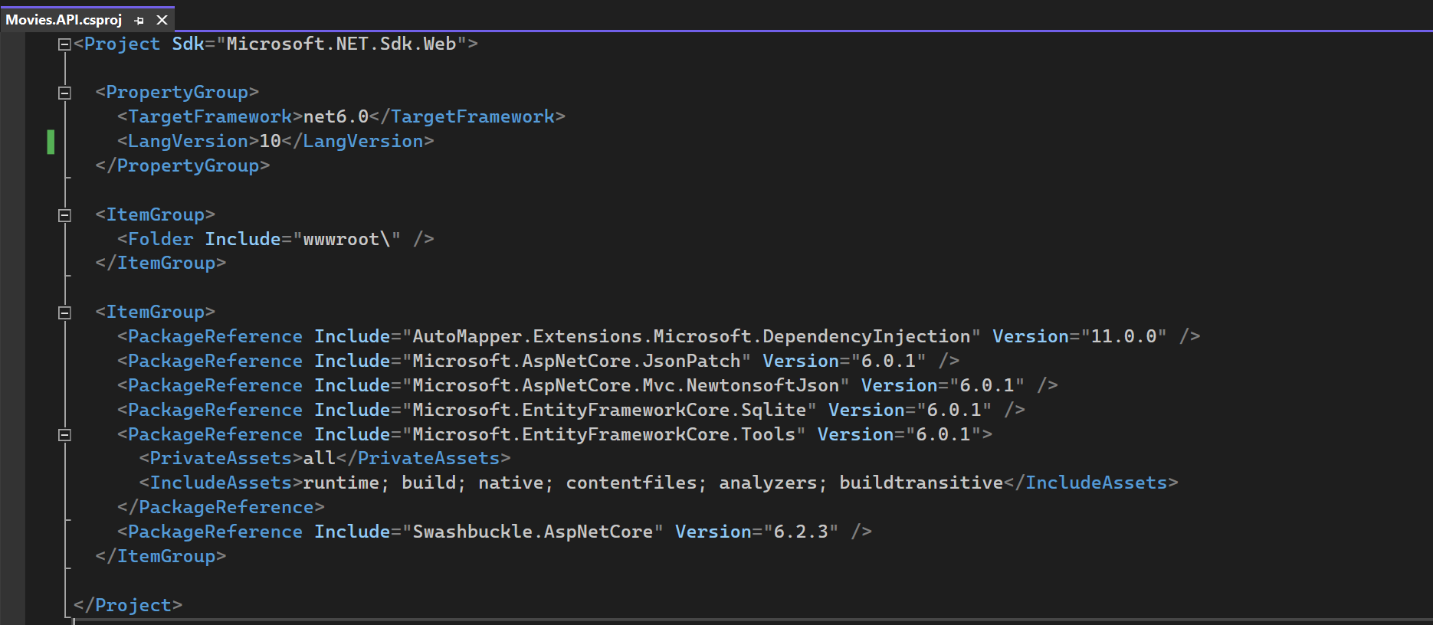
Starter project

Slide 4
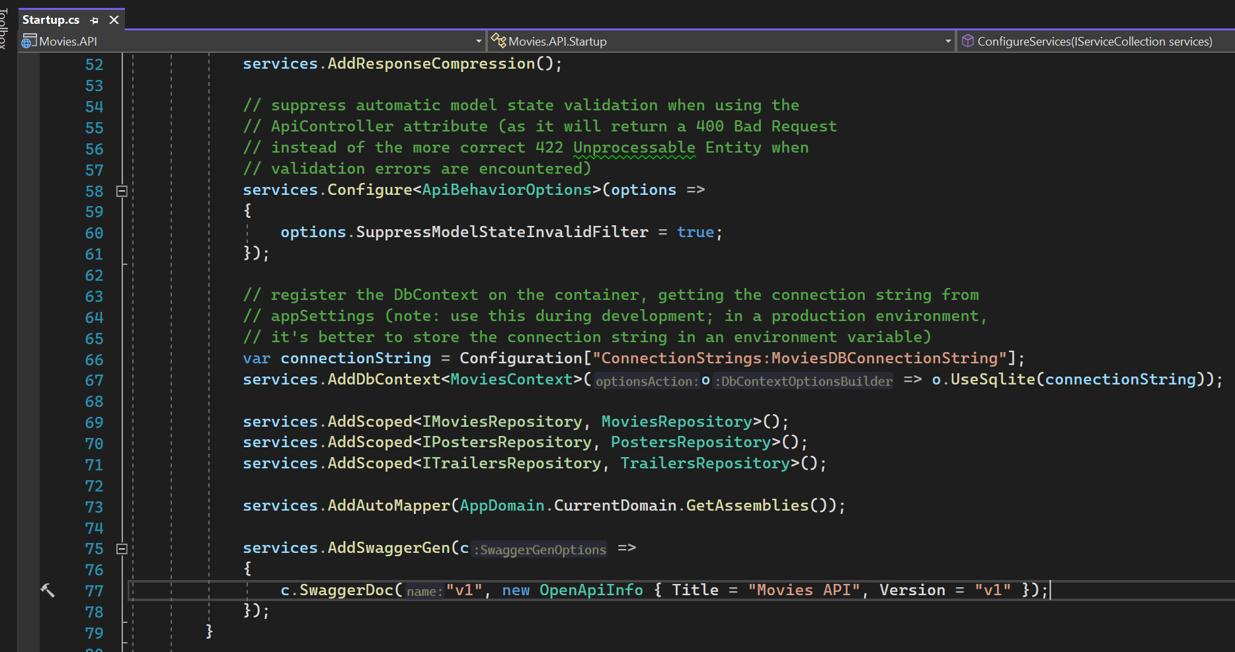
SQL LITE AS DATABASE

Slide 5
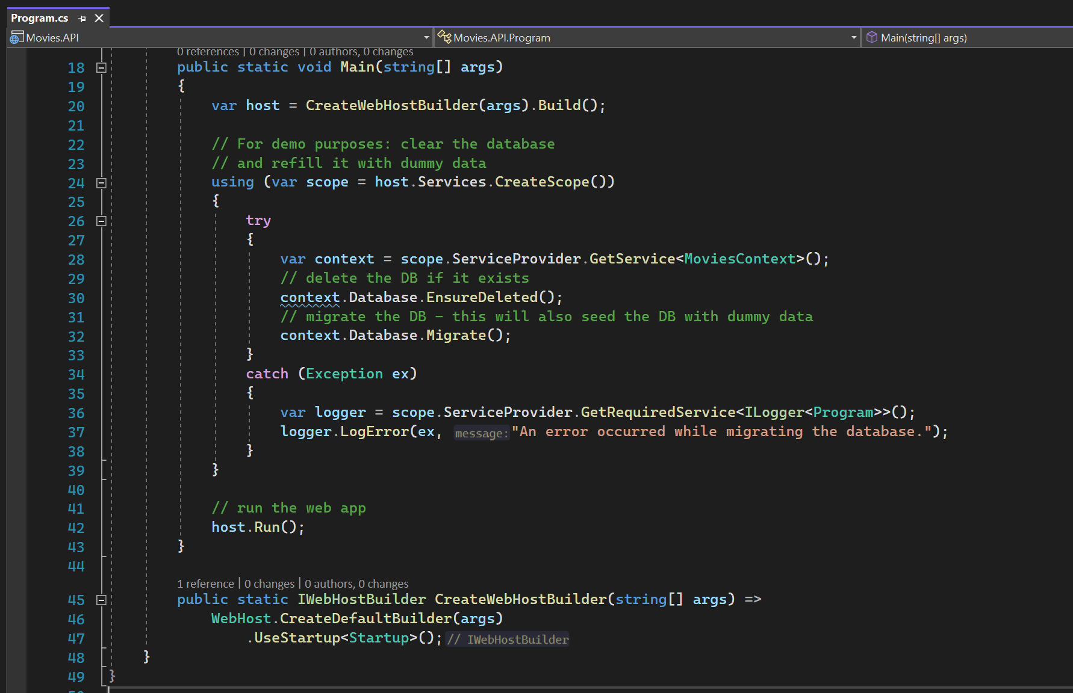
Databases are recreated

Slide 6
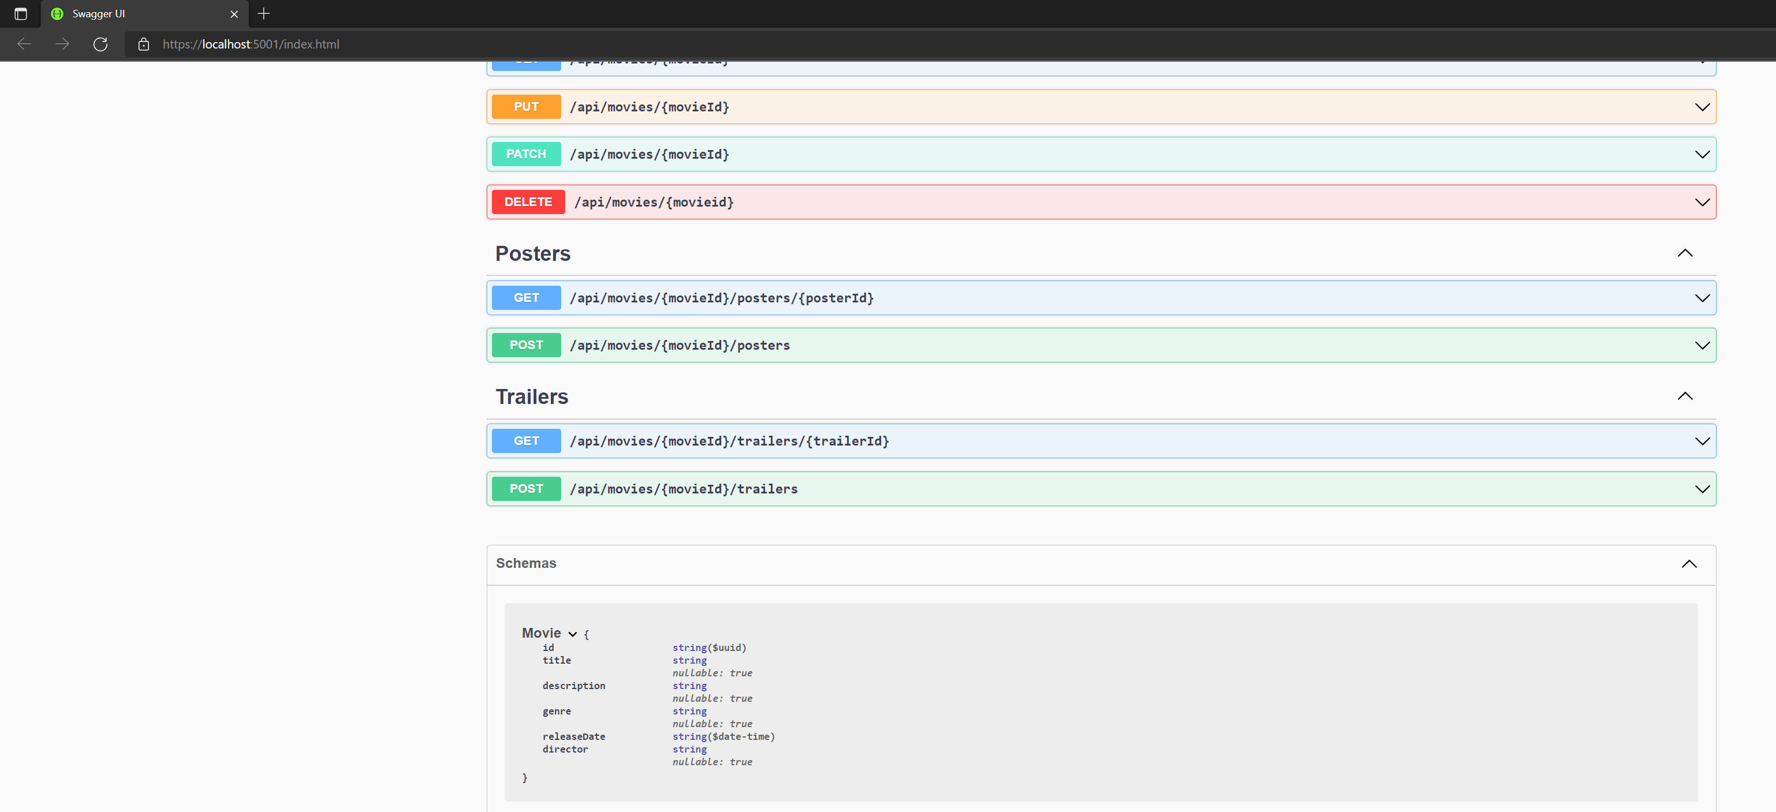
Exposed models

Slide 7
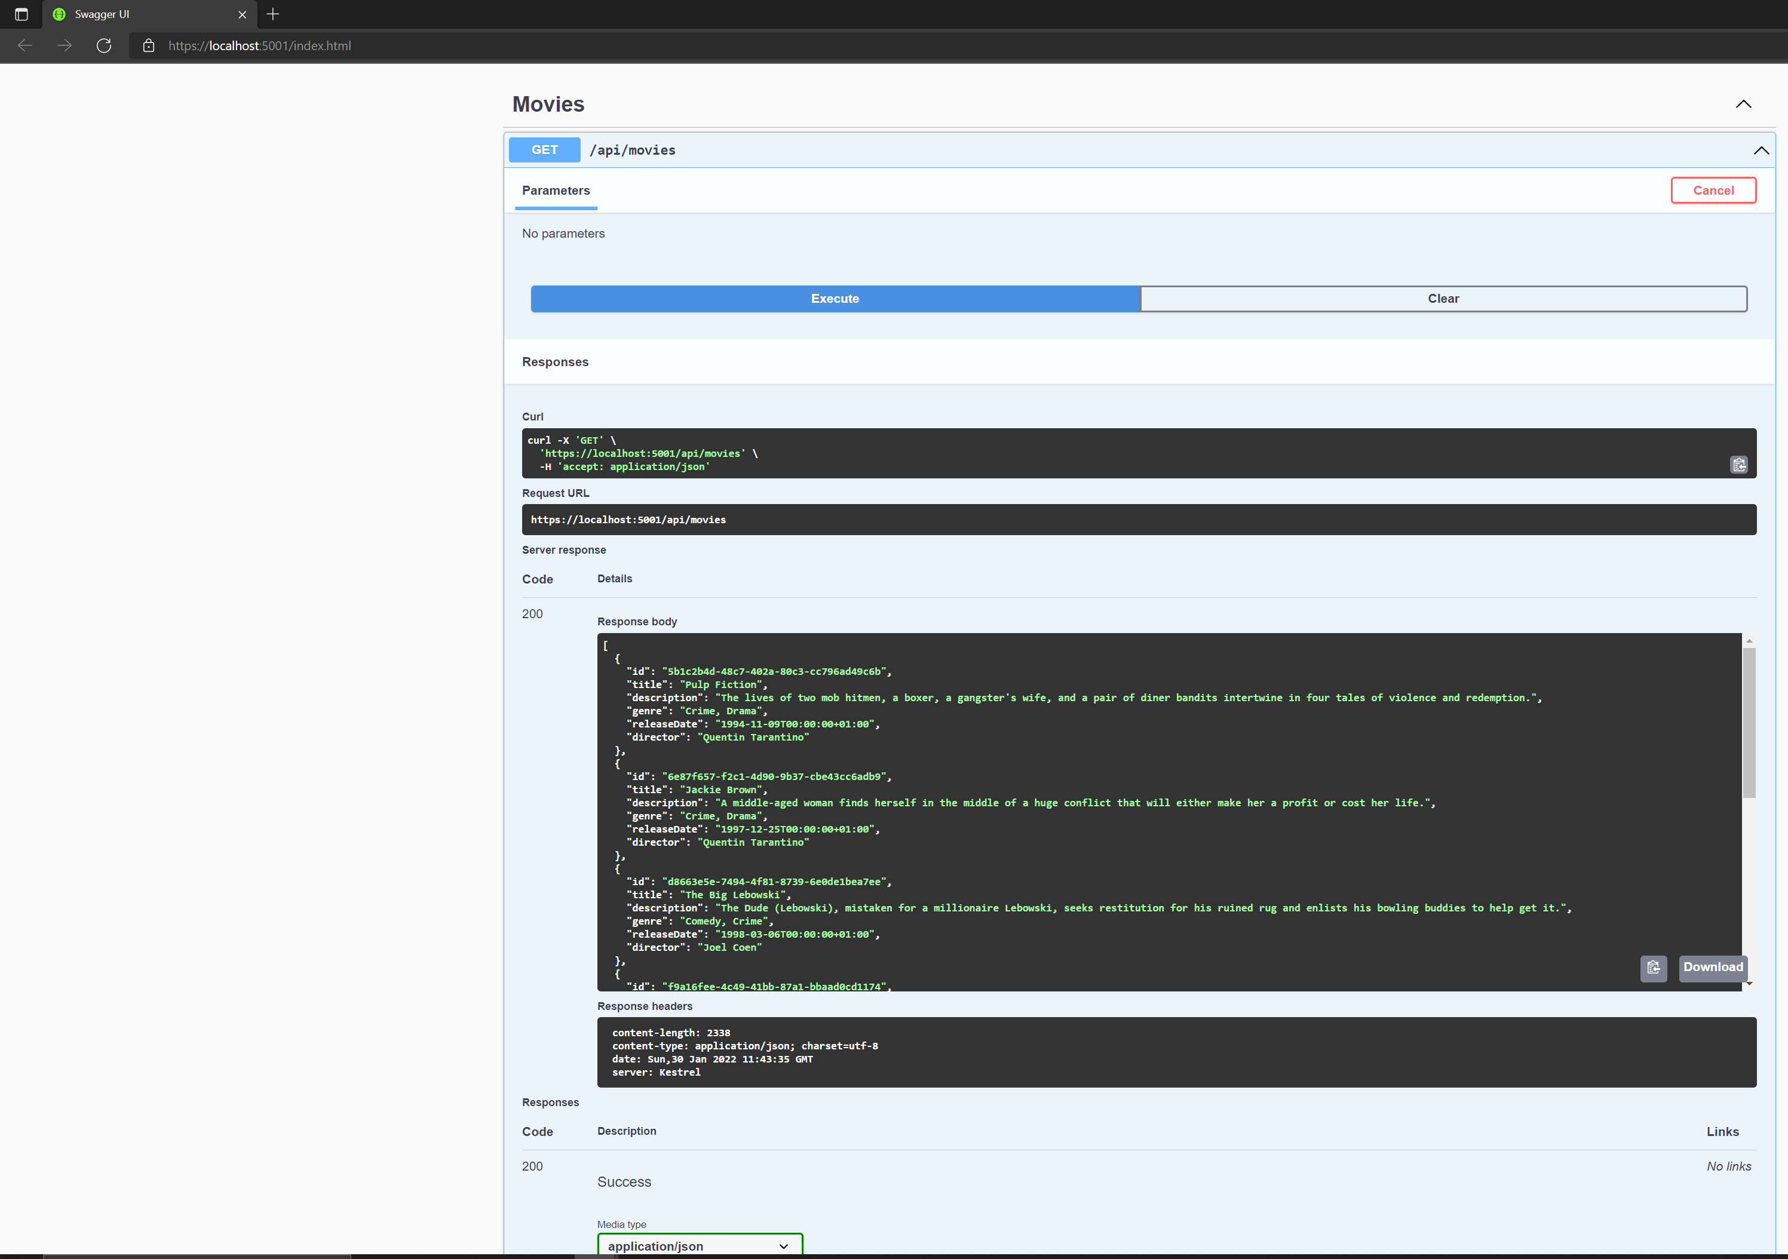
Setting up starter

Slide 8
Movie's client

Slide 9
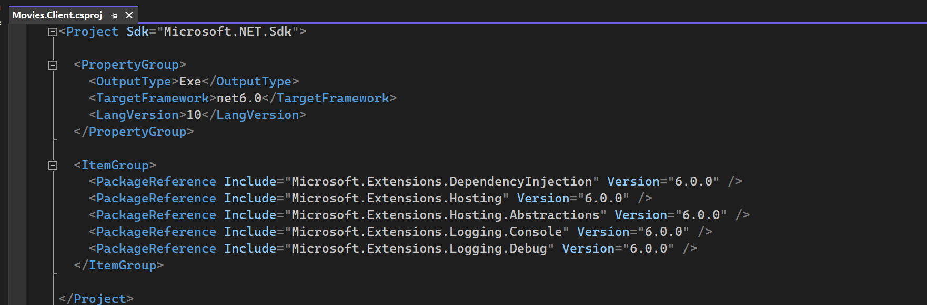
Client project details

Slide 10
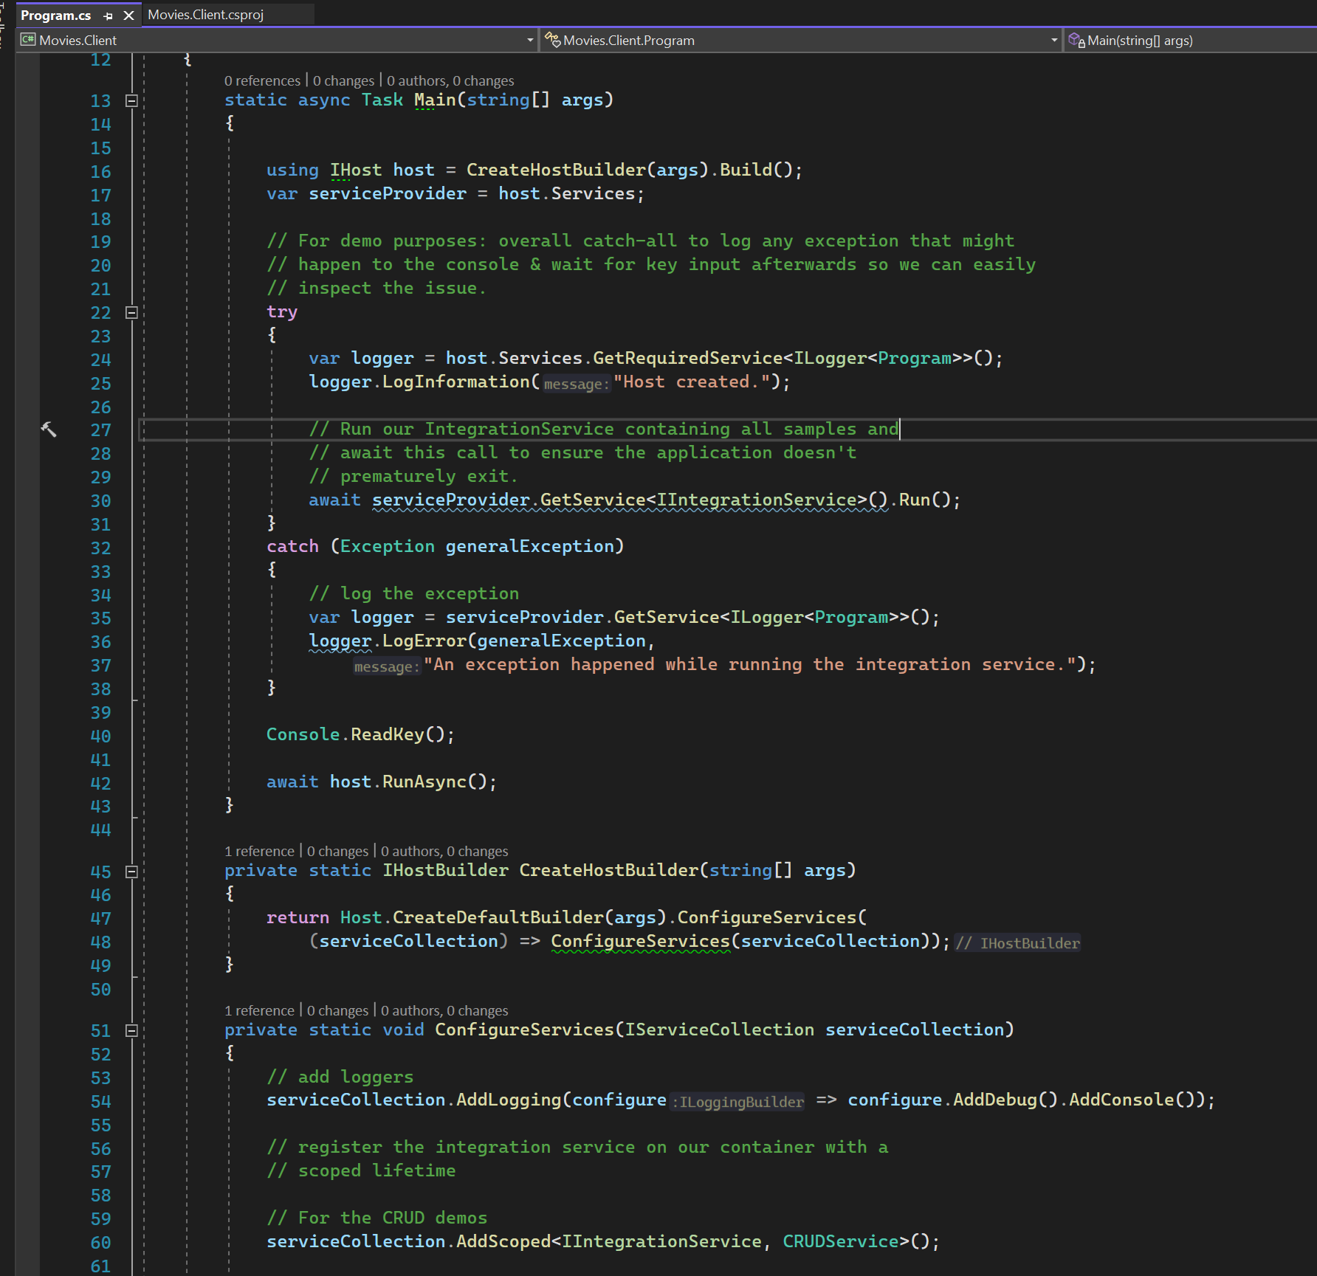
CLIENT BASIC SETUP

Slide 11
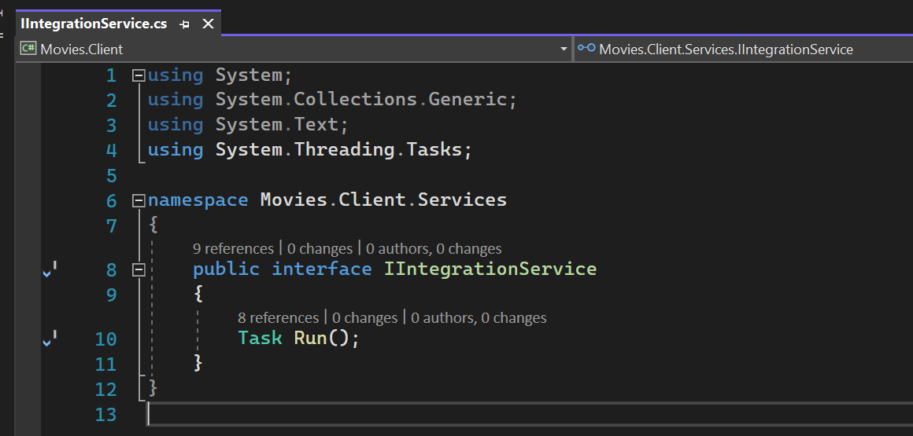
Integration service

Slide 12
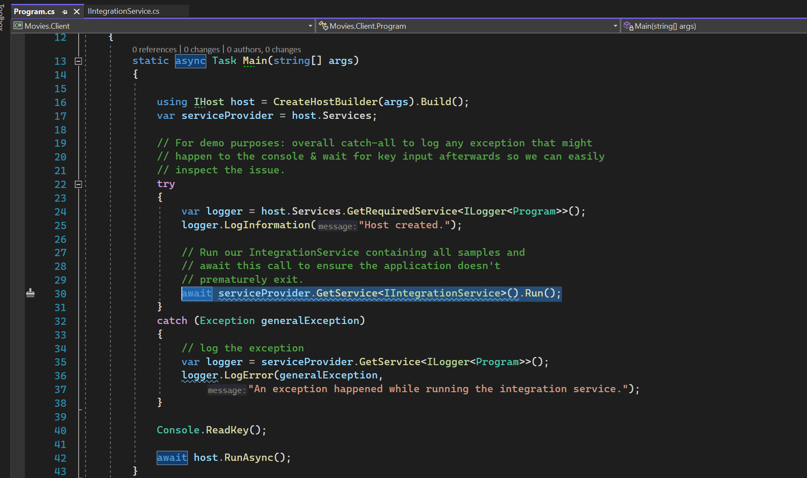
Integration service run method

Slide 13
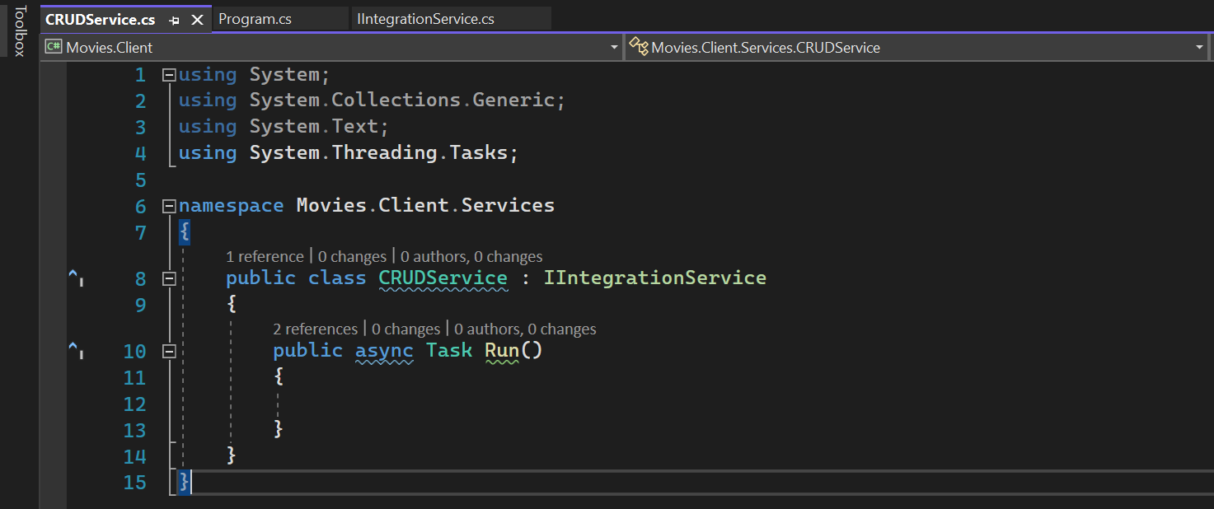
Crud service

Slide 14
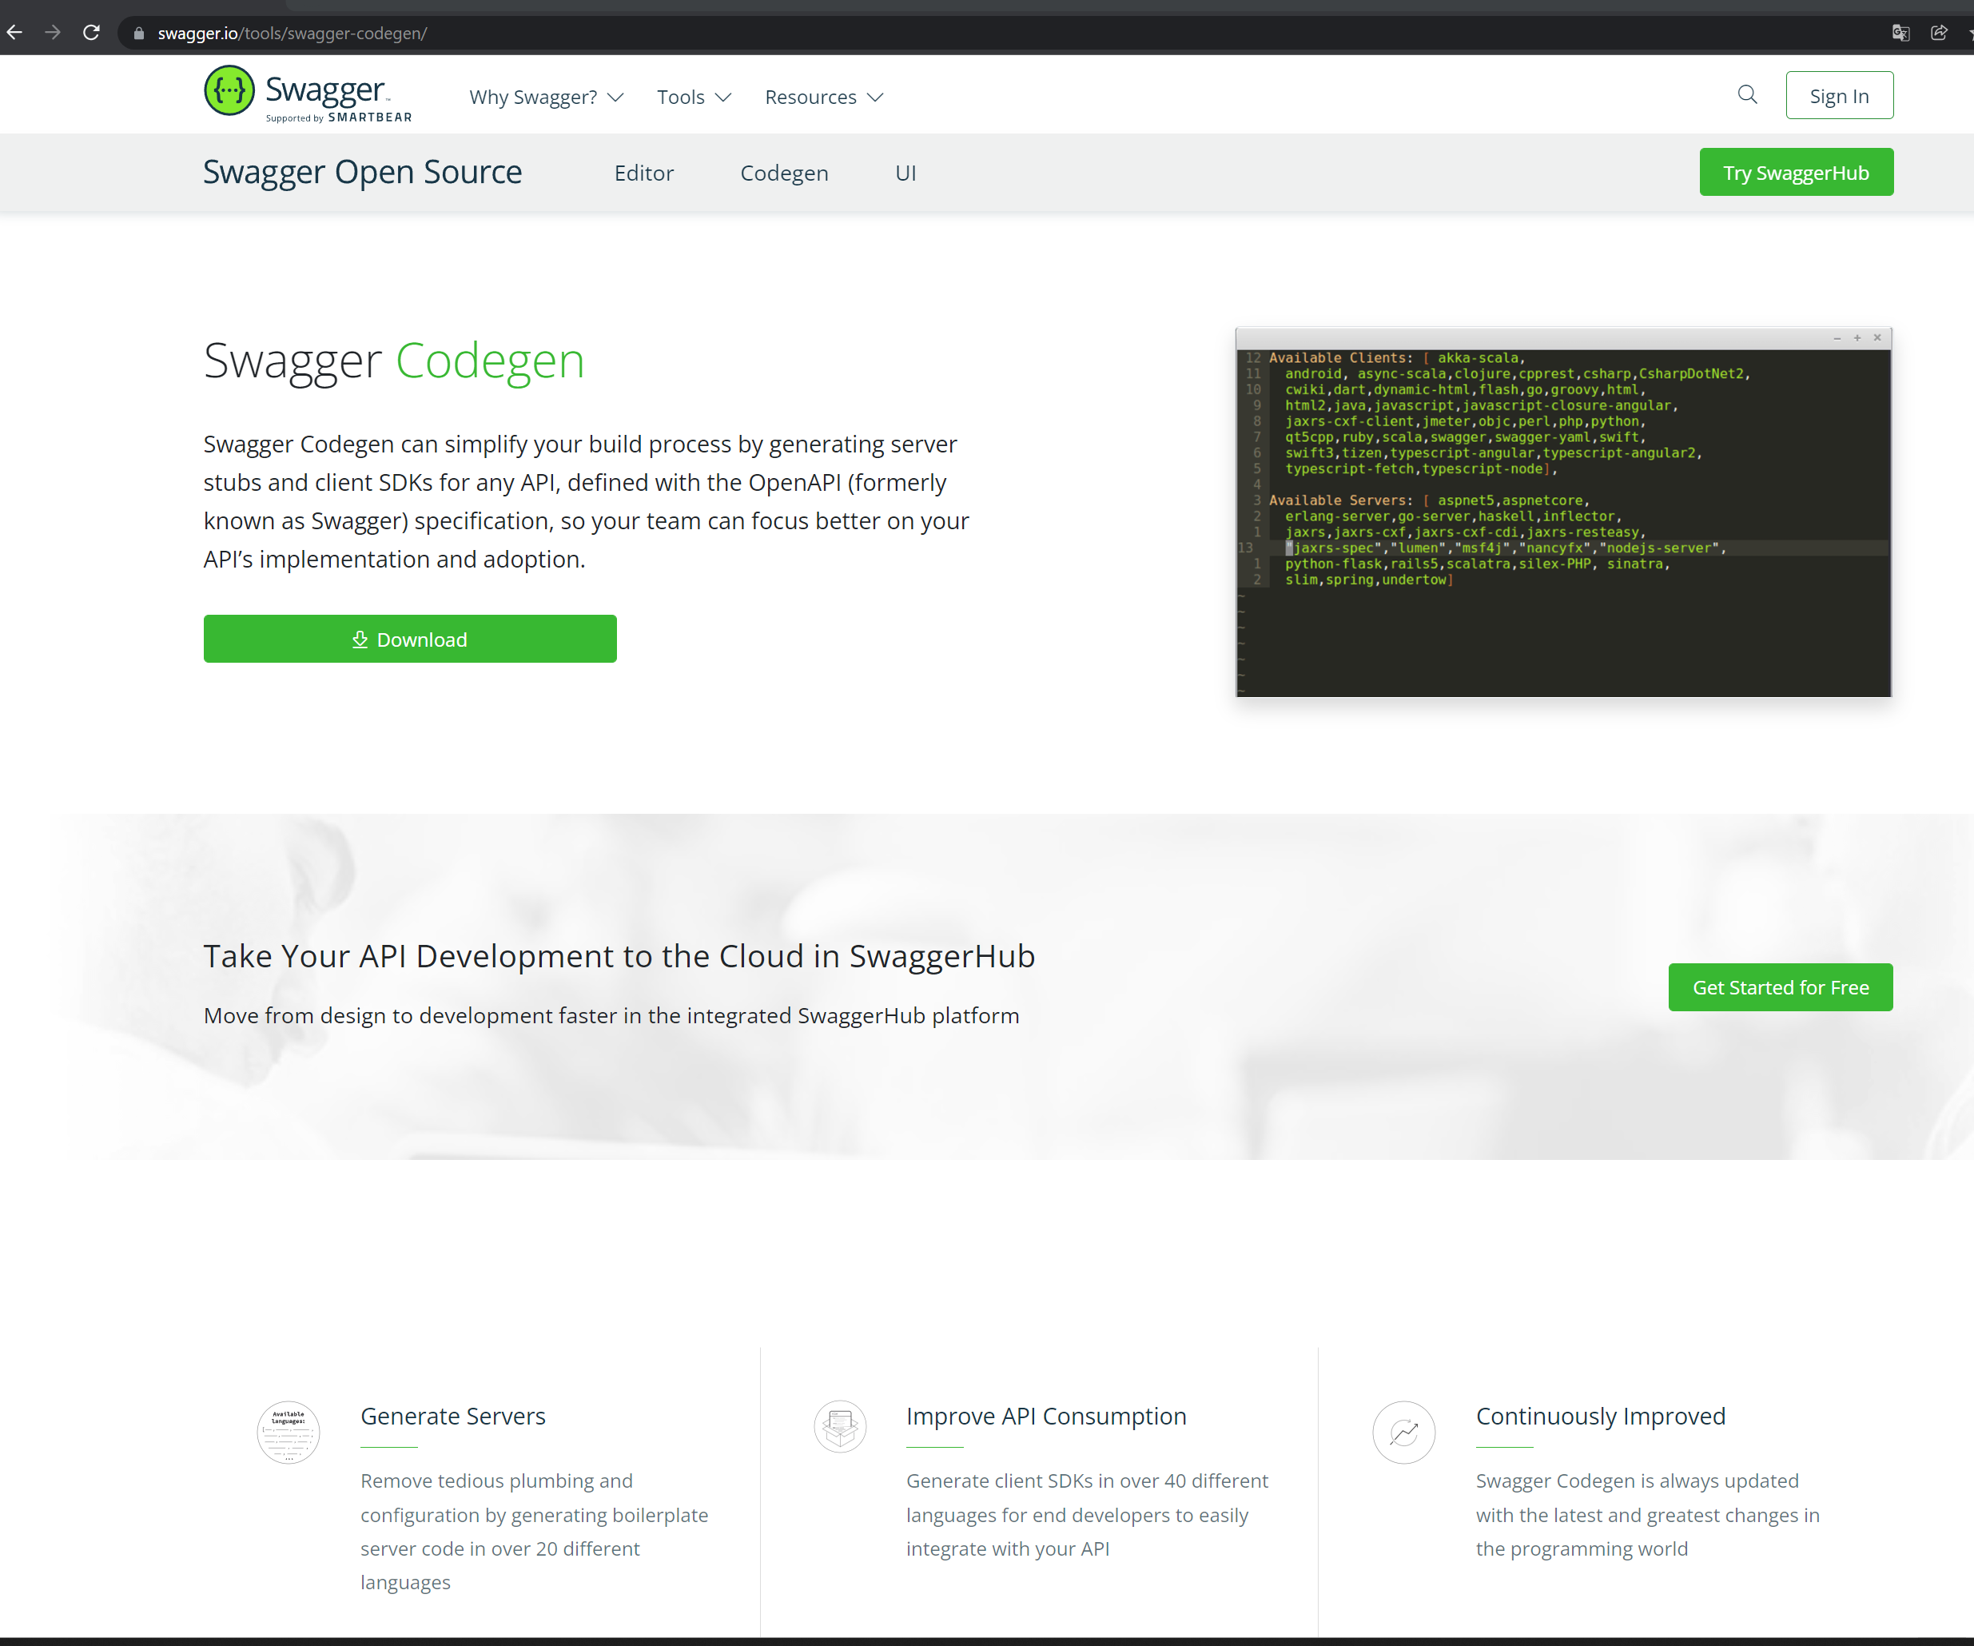
Generating dto classes - 1
https://swagger.io/tools/swagger-codegen/

Slide 15
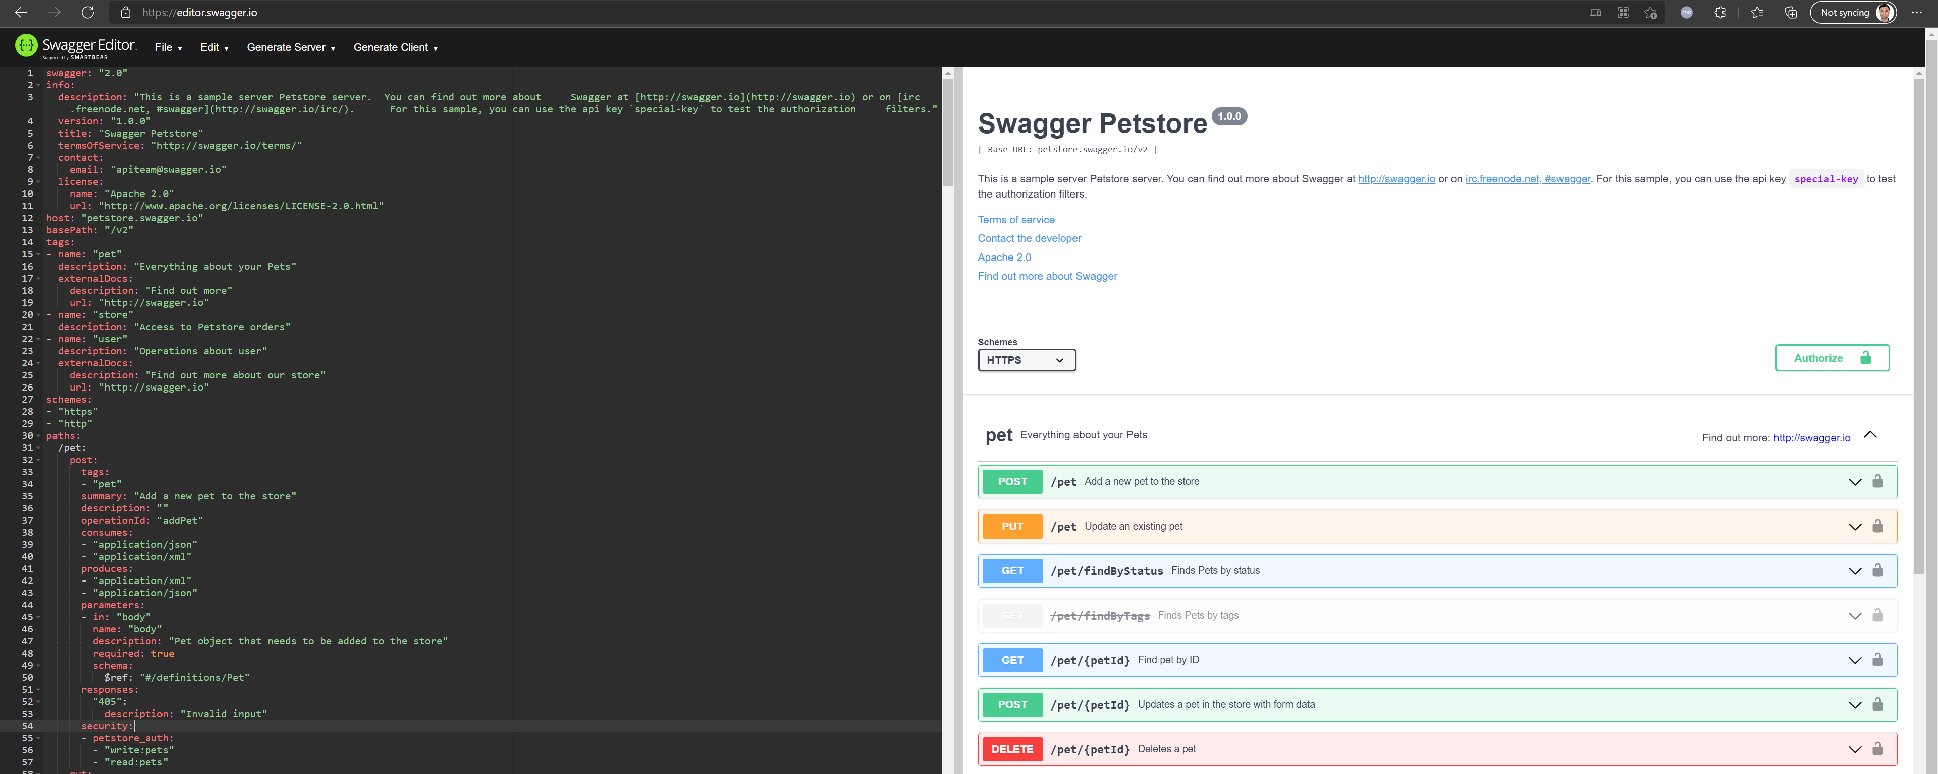
Generating dto classes - 2
Swagger Editor

Slide 16
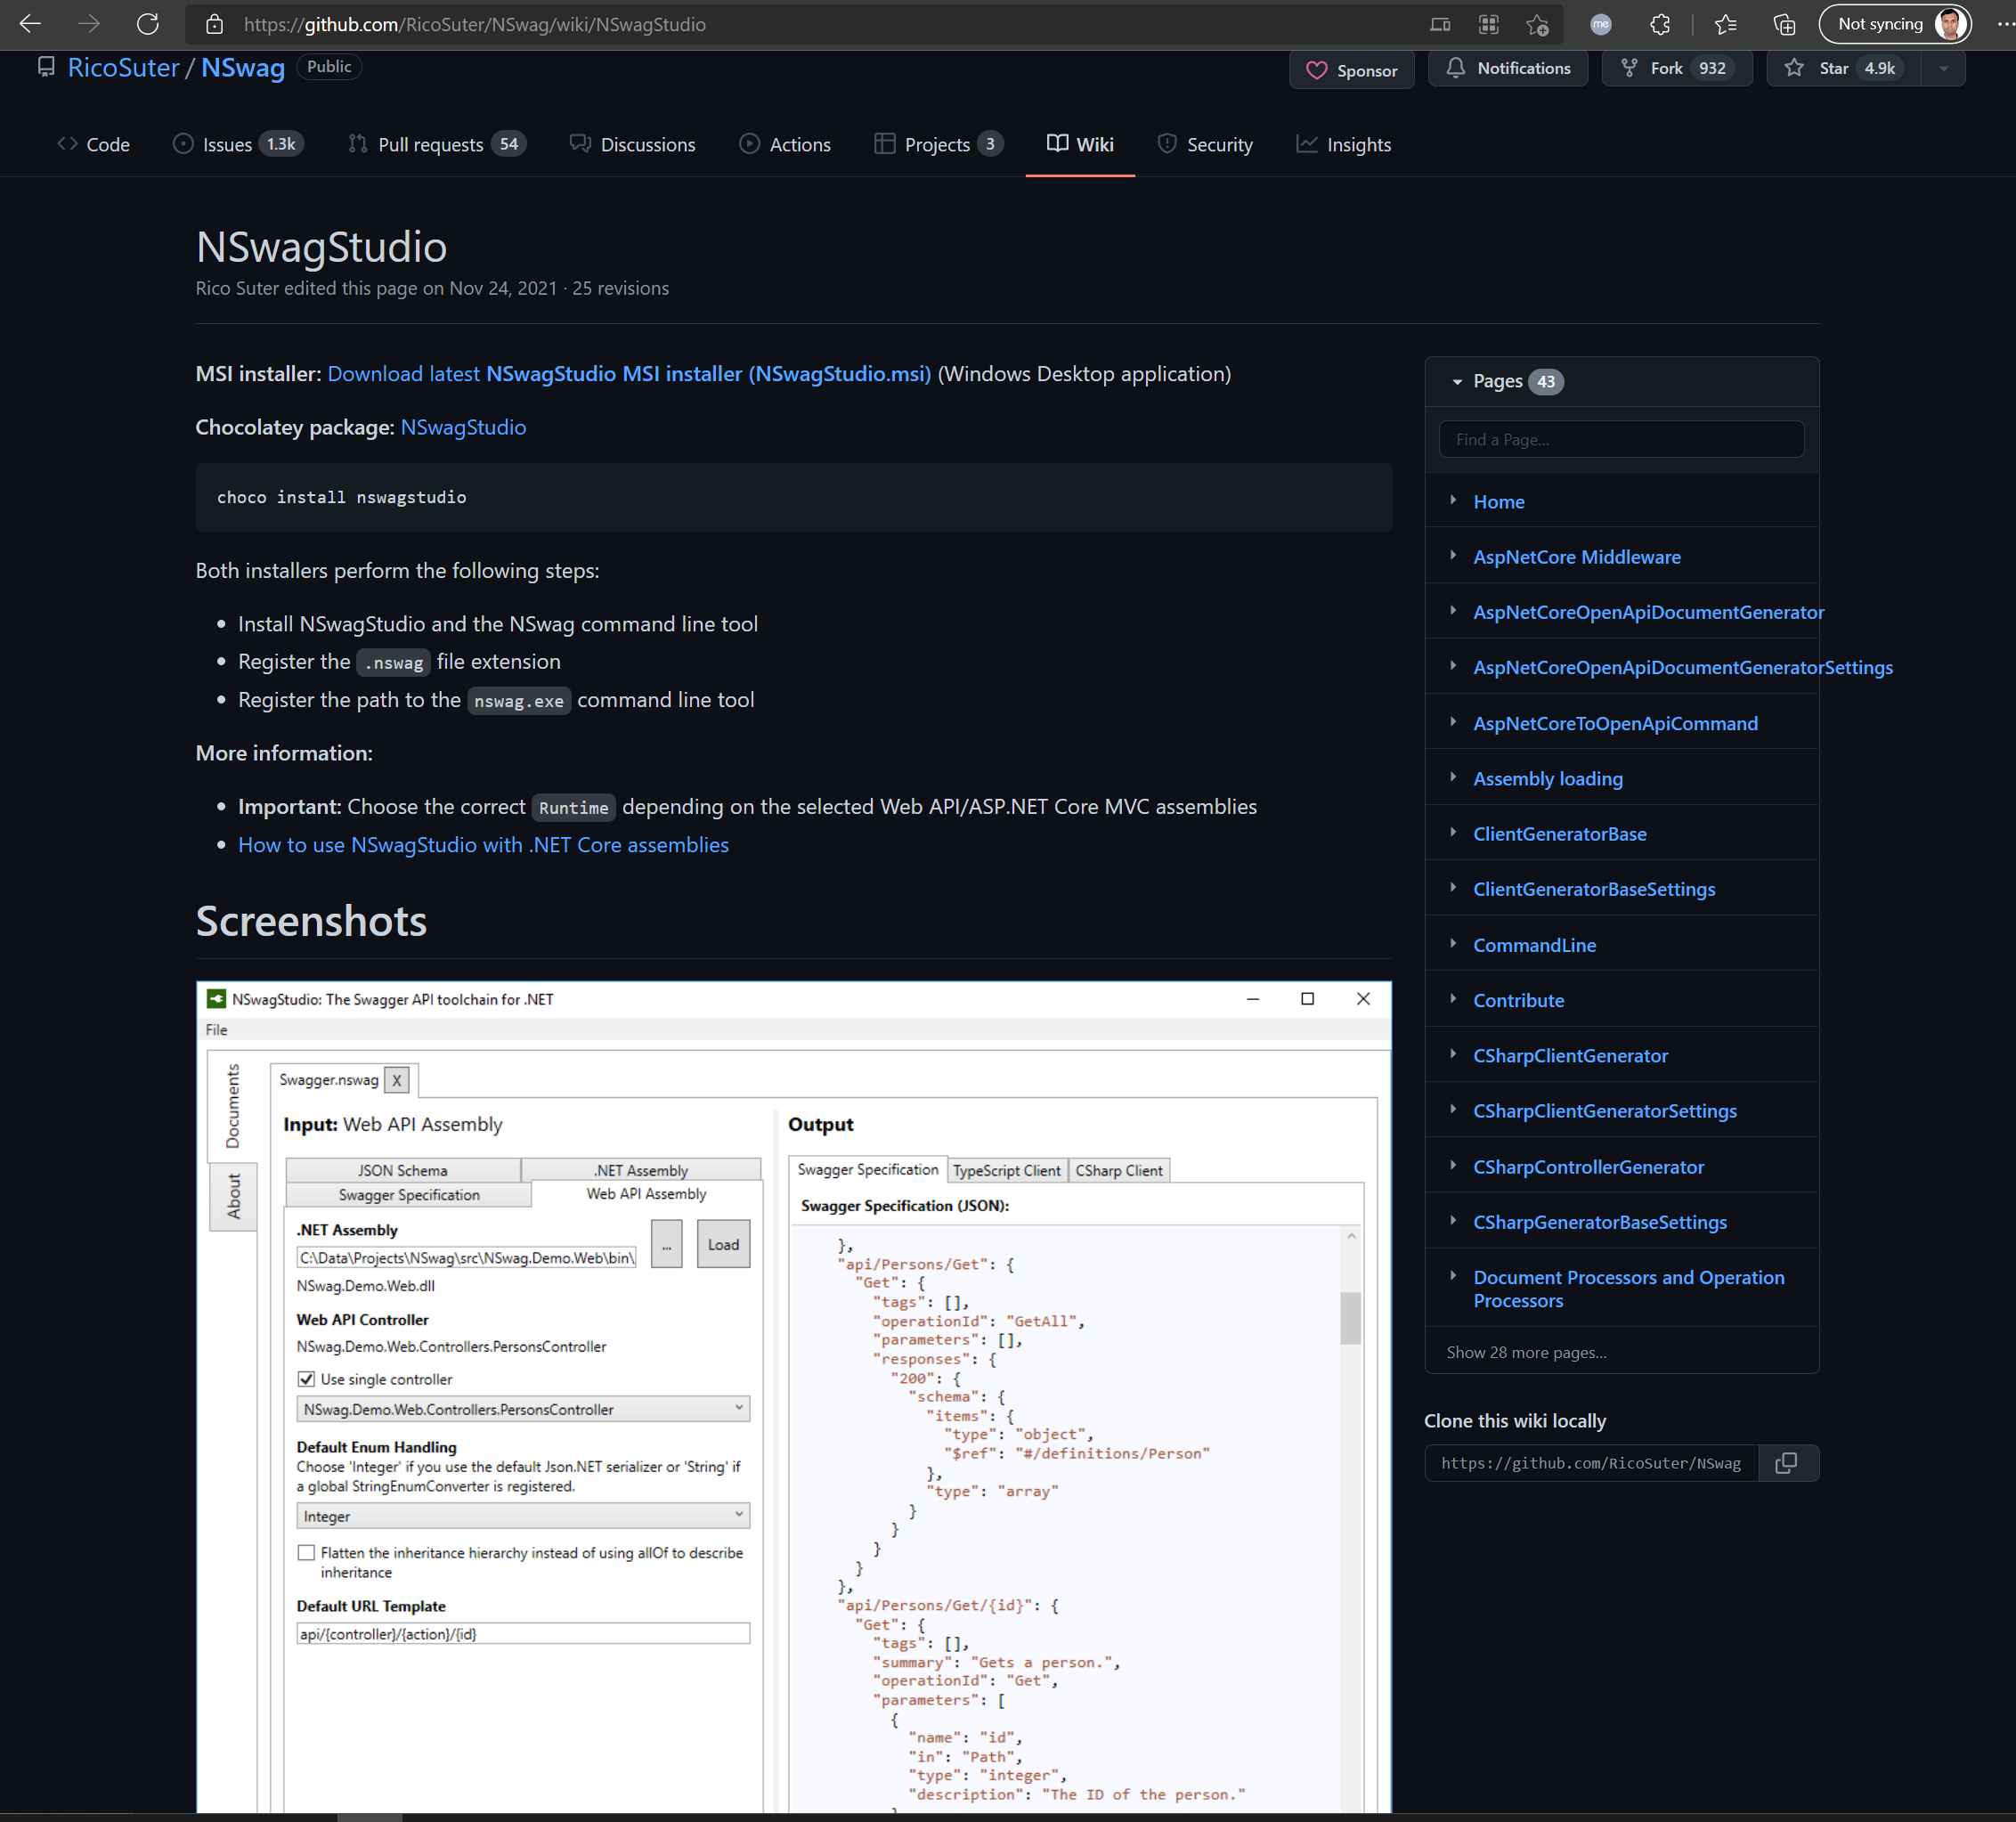
Generating dto classes - 3
NSwagStudio · RicoSuter/NSwag Wiki · GitHub

Slide 17
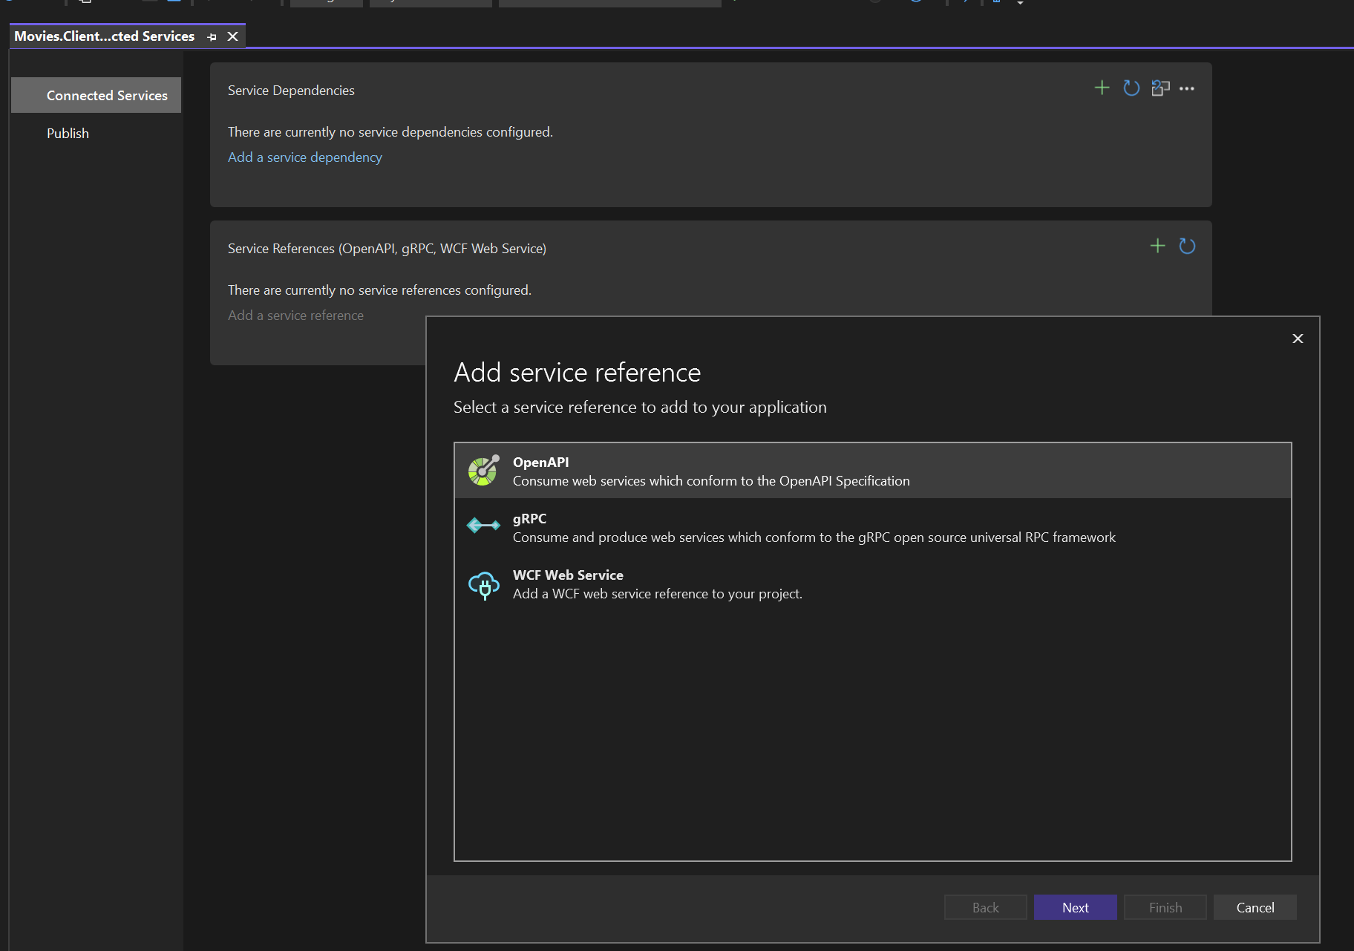
Generating dto classes - 4
Add connected service

Slide 18
Generating dto classes from visual studio

Slide 19
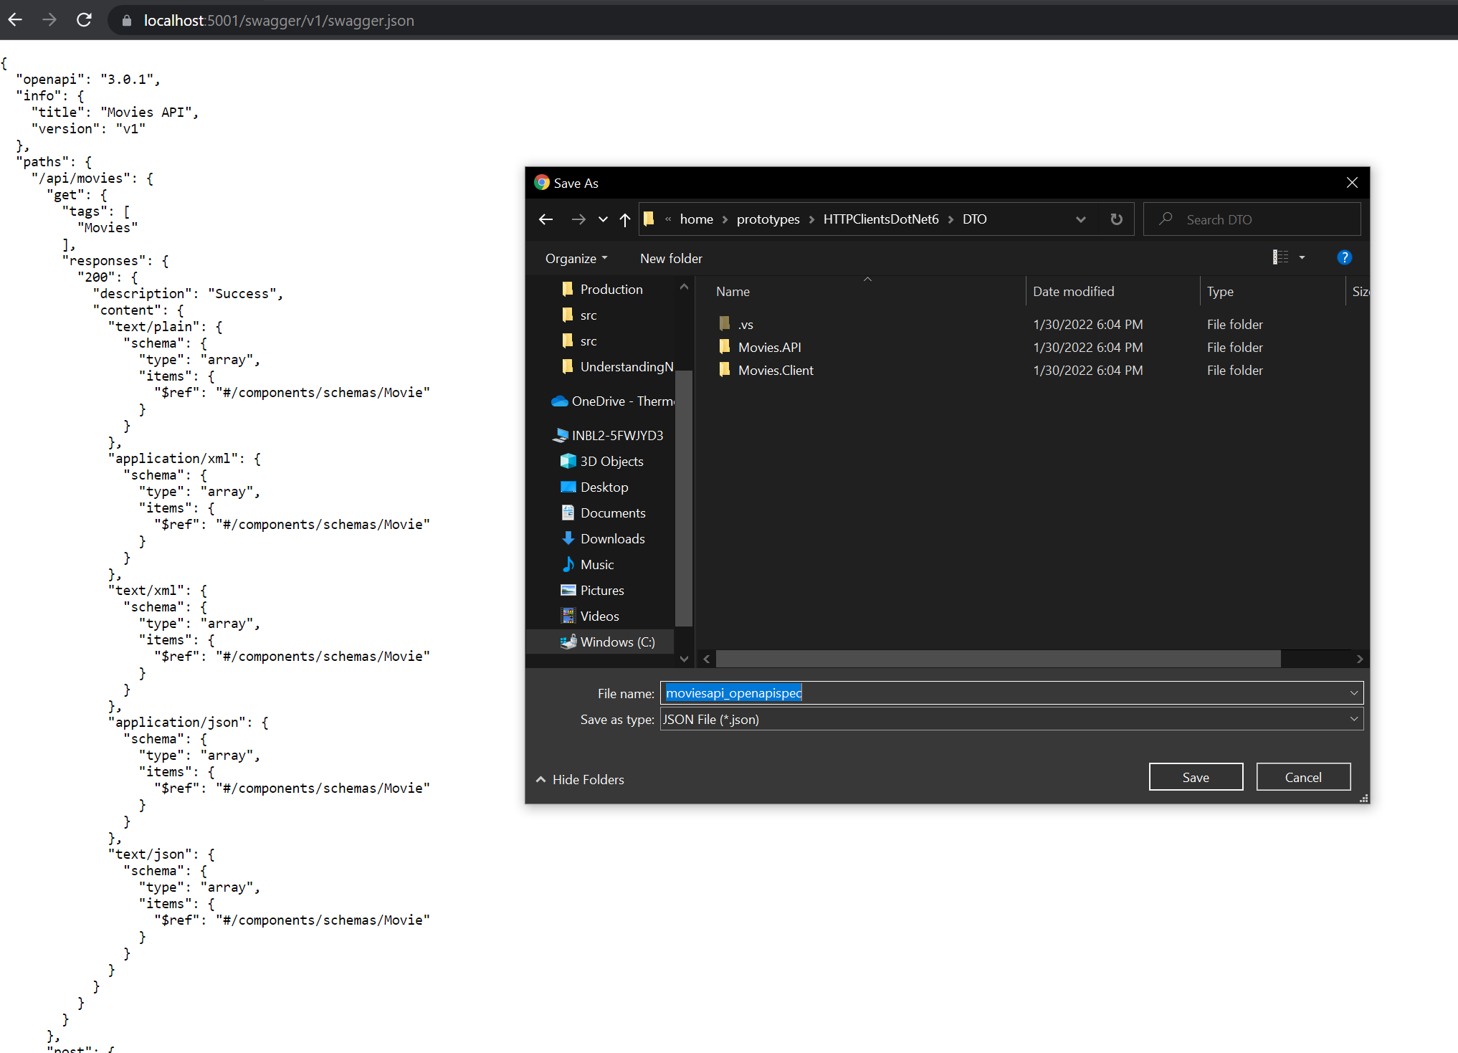
MOVIES OPEN API SPEC

Slide 20
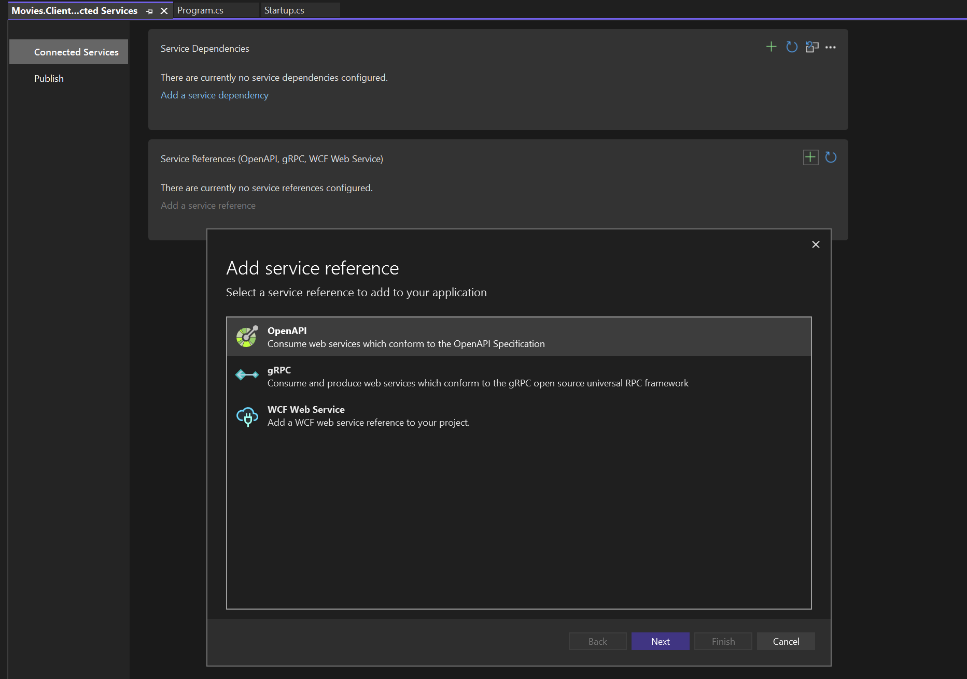
openAPI

Slide 21
openAPI

Slide 22
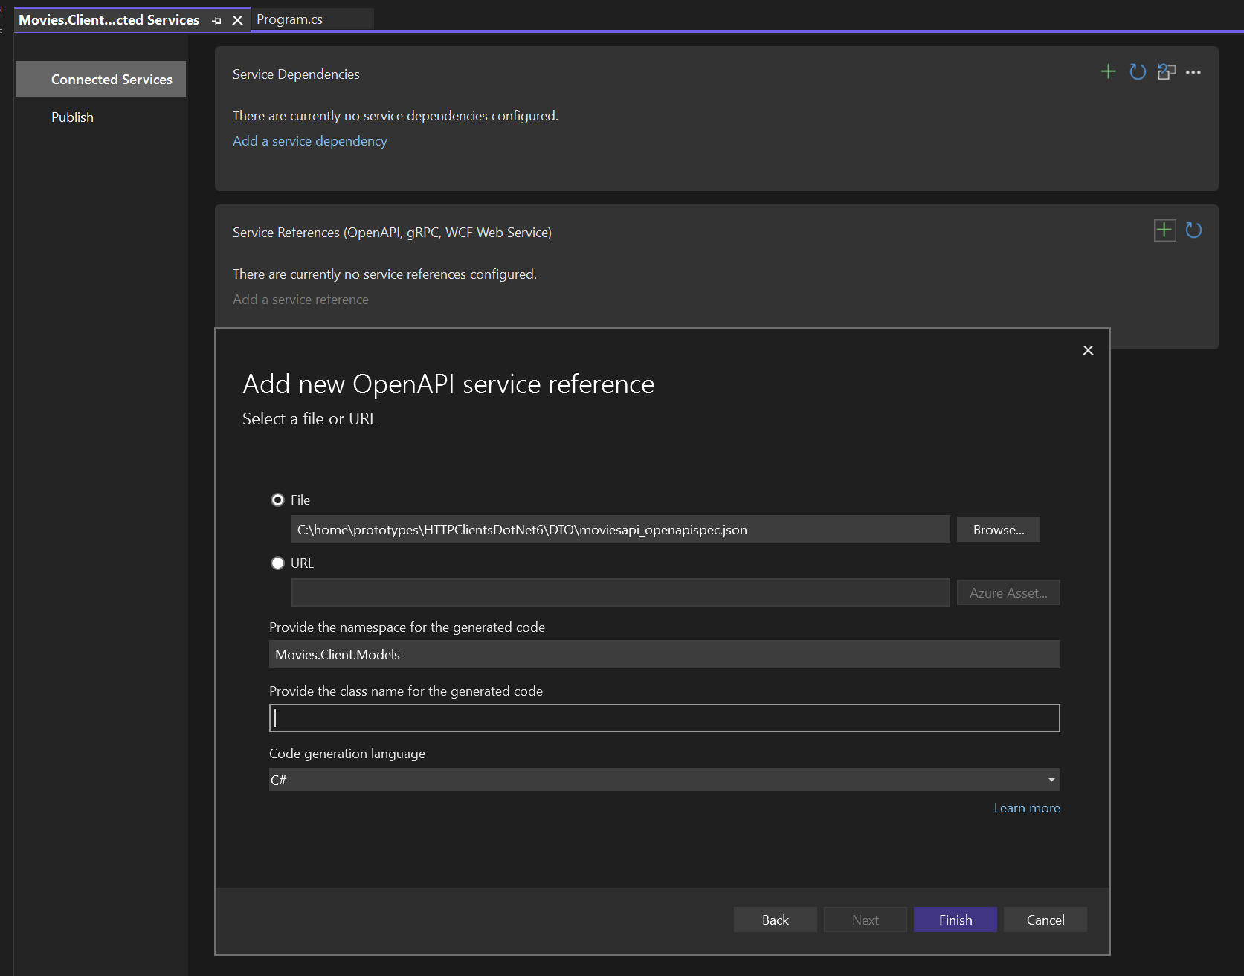
openAPI service reference

Slide 23
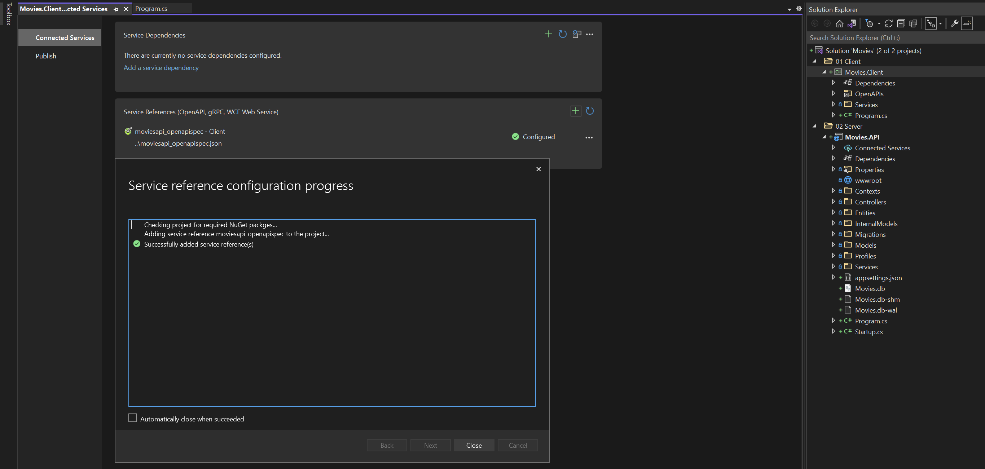
openAPI service reference

Slide 24
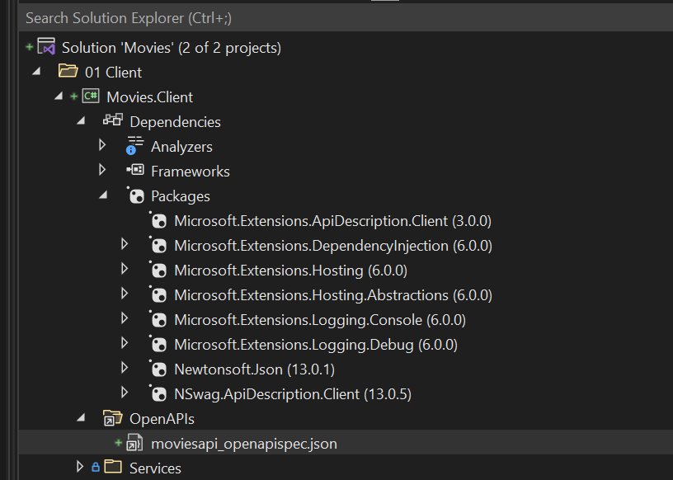
openAPI service reference

Slide 25
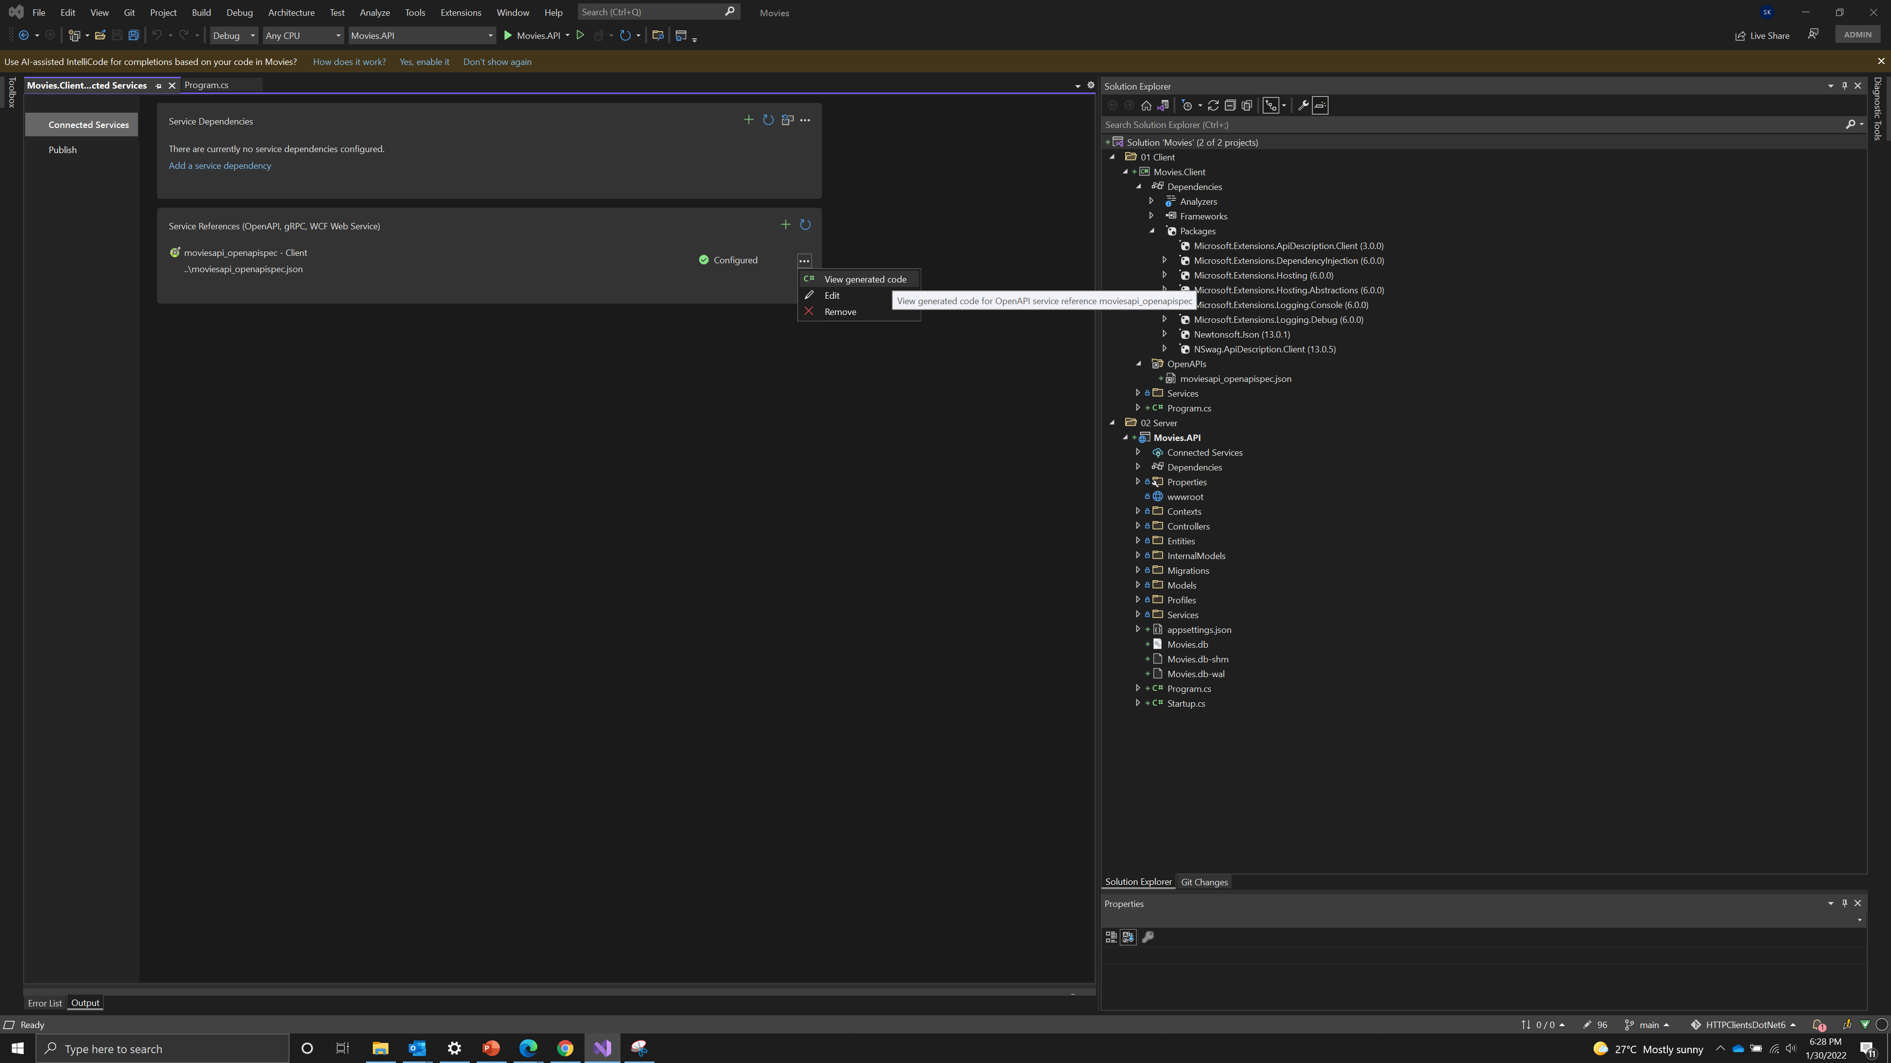
openAPI service reference

Slide 26
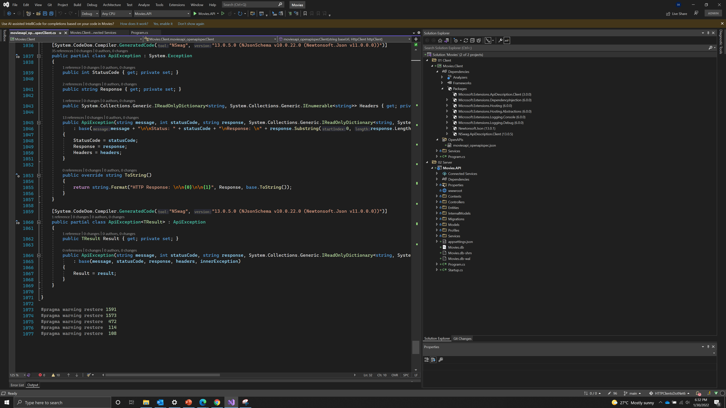
Lot of code – Good for prototypes but not for production

Slide 27
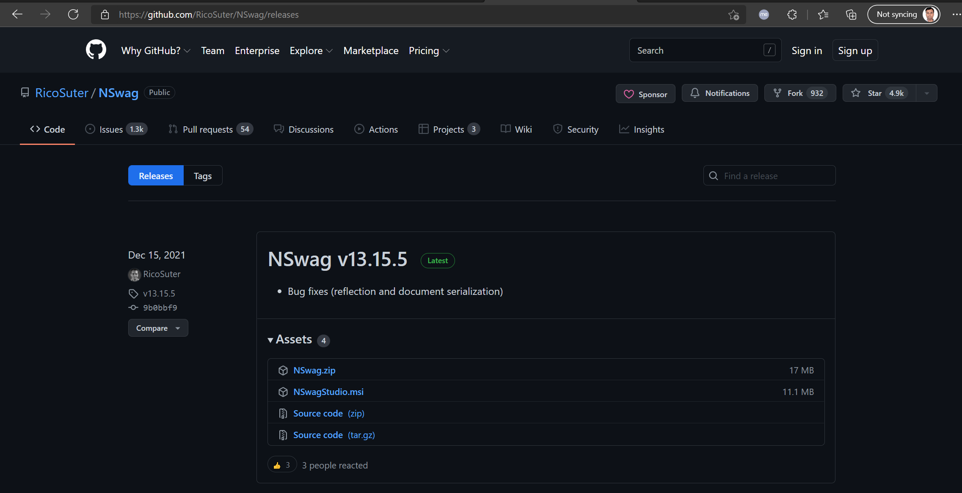
Install Nswag studio

Slide 28
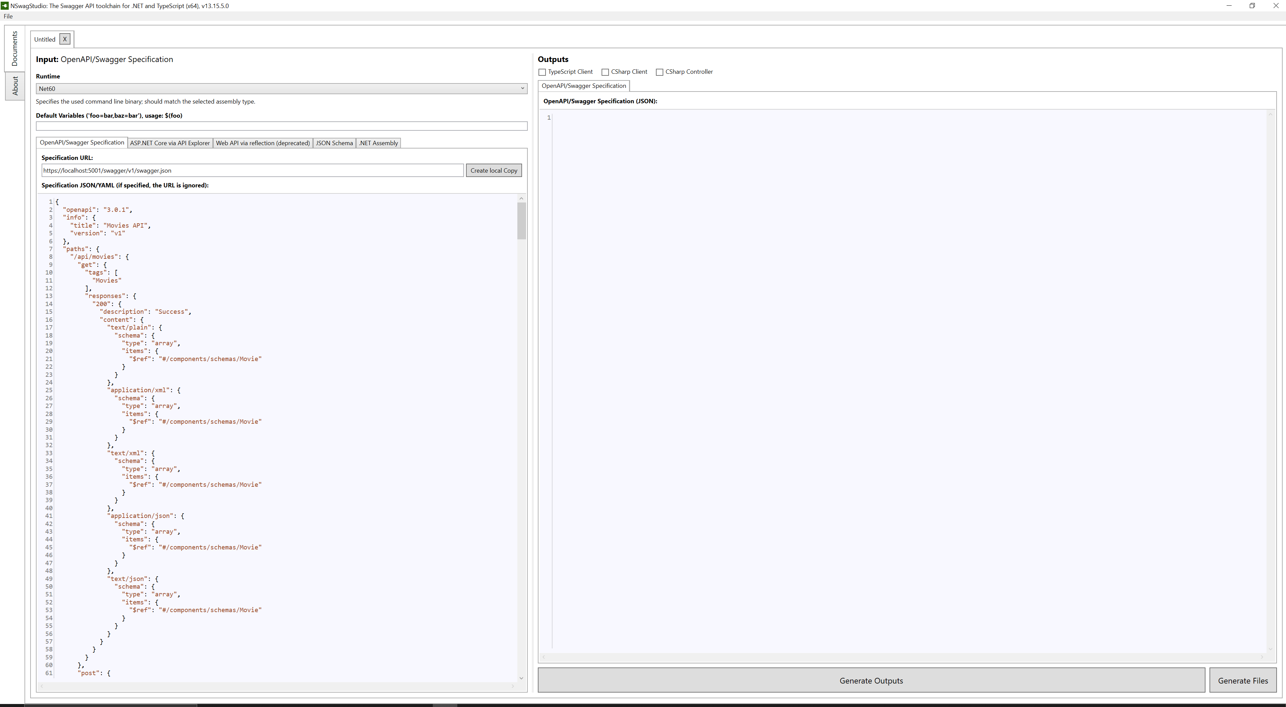
Nswag studio – create local copy

Slide 29
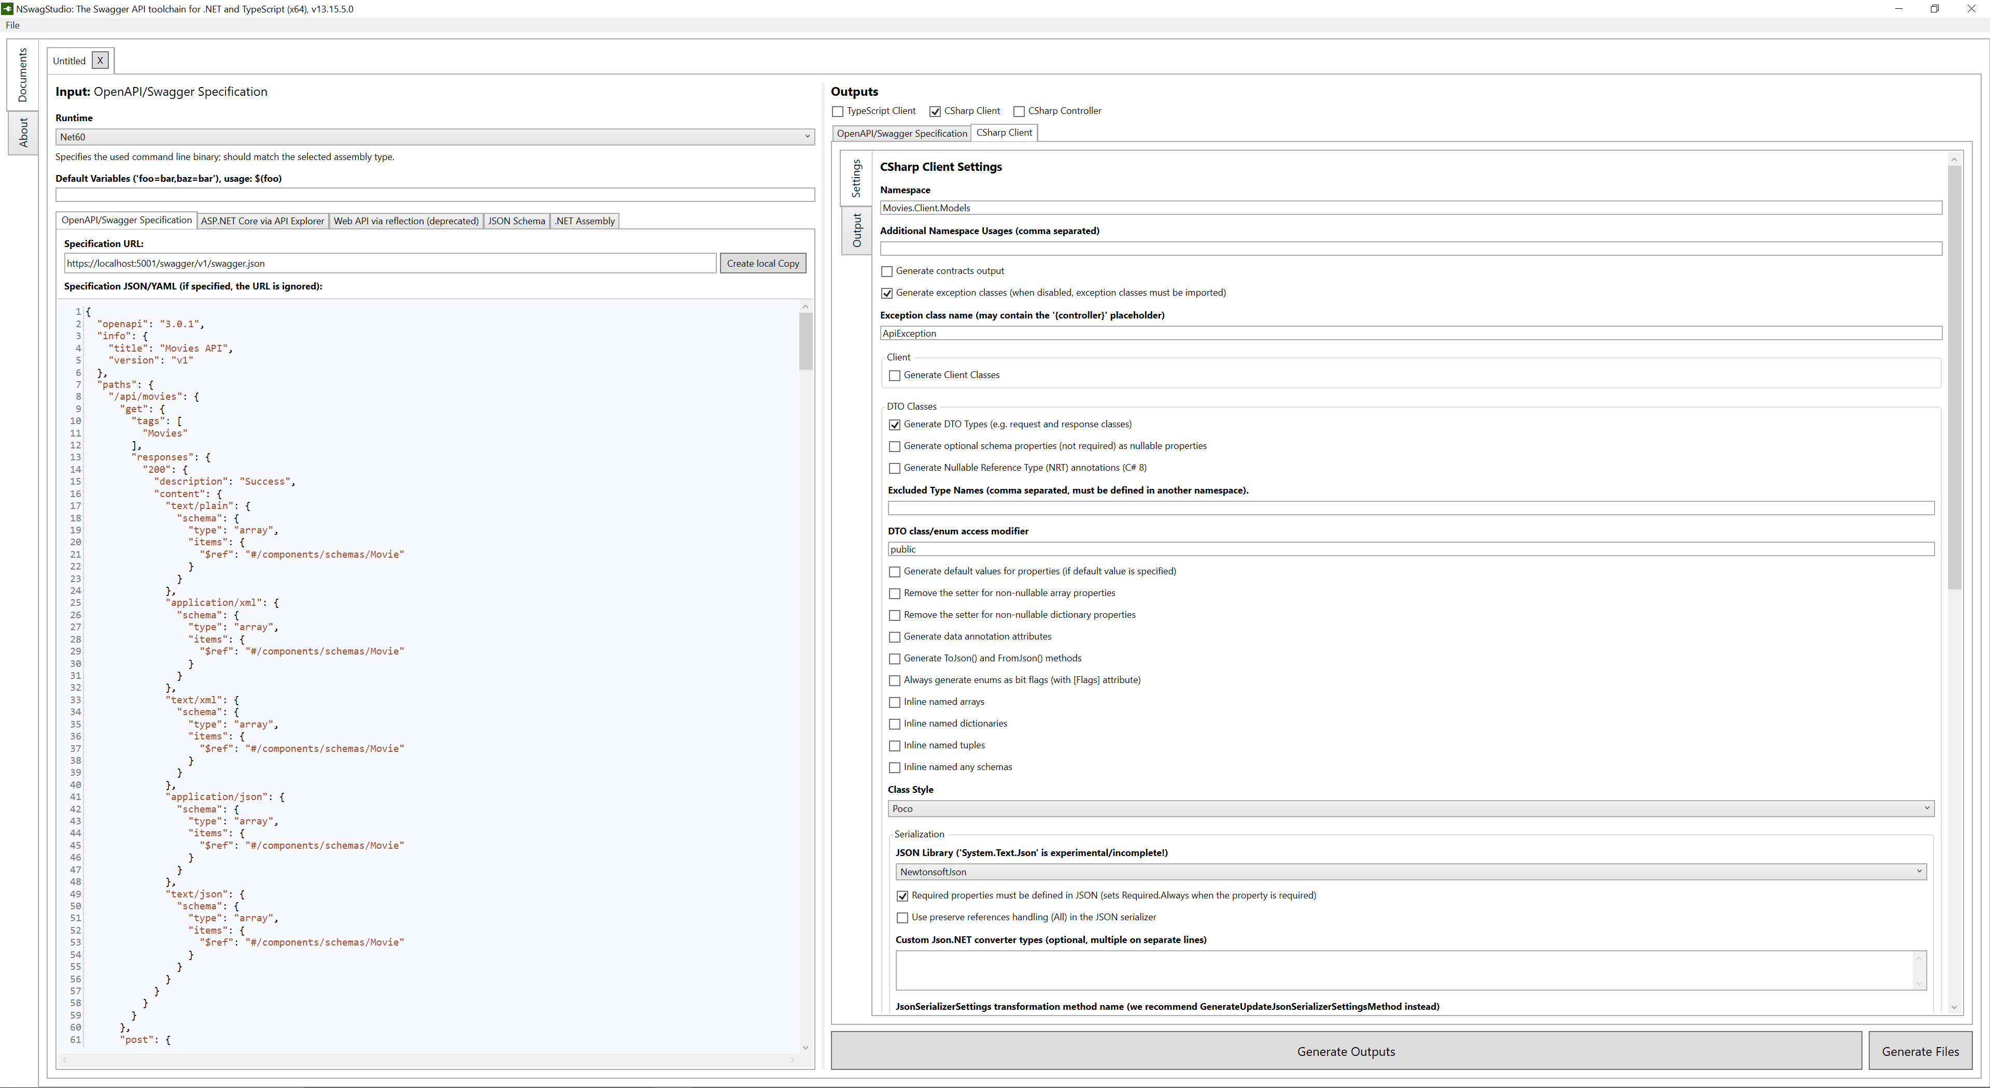
Nswag studio - 1

Slide 30
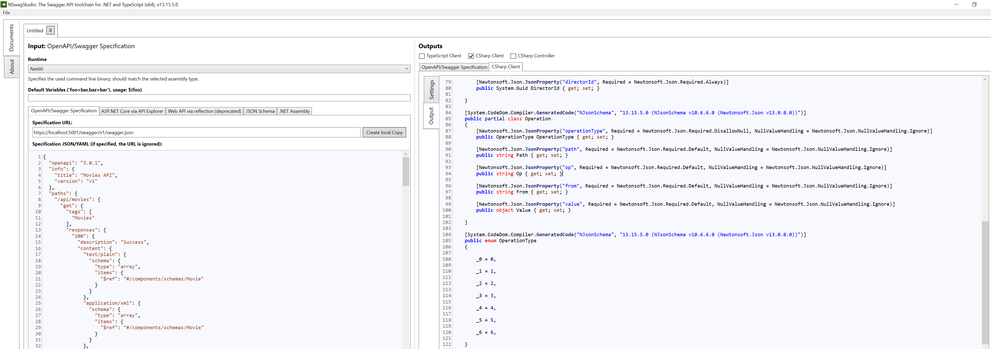
Nswag studio – 2 – Operation, operation type

Slide 31
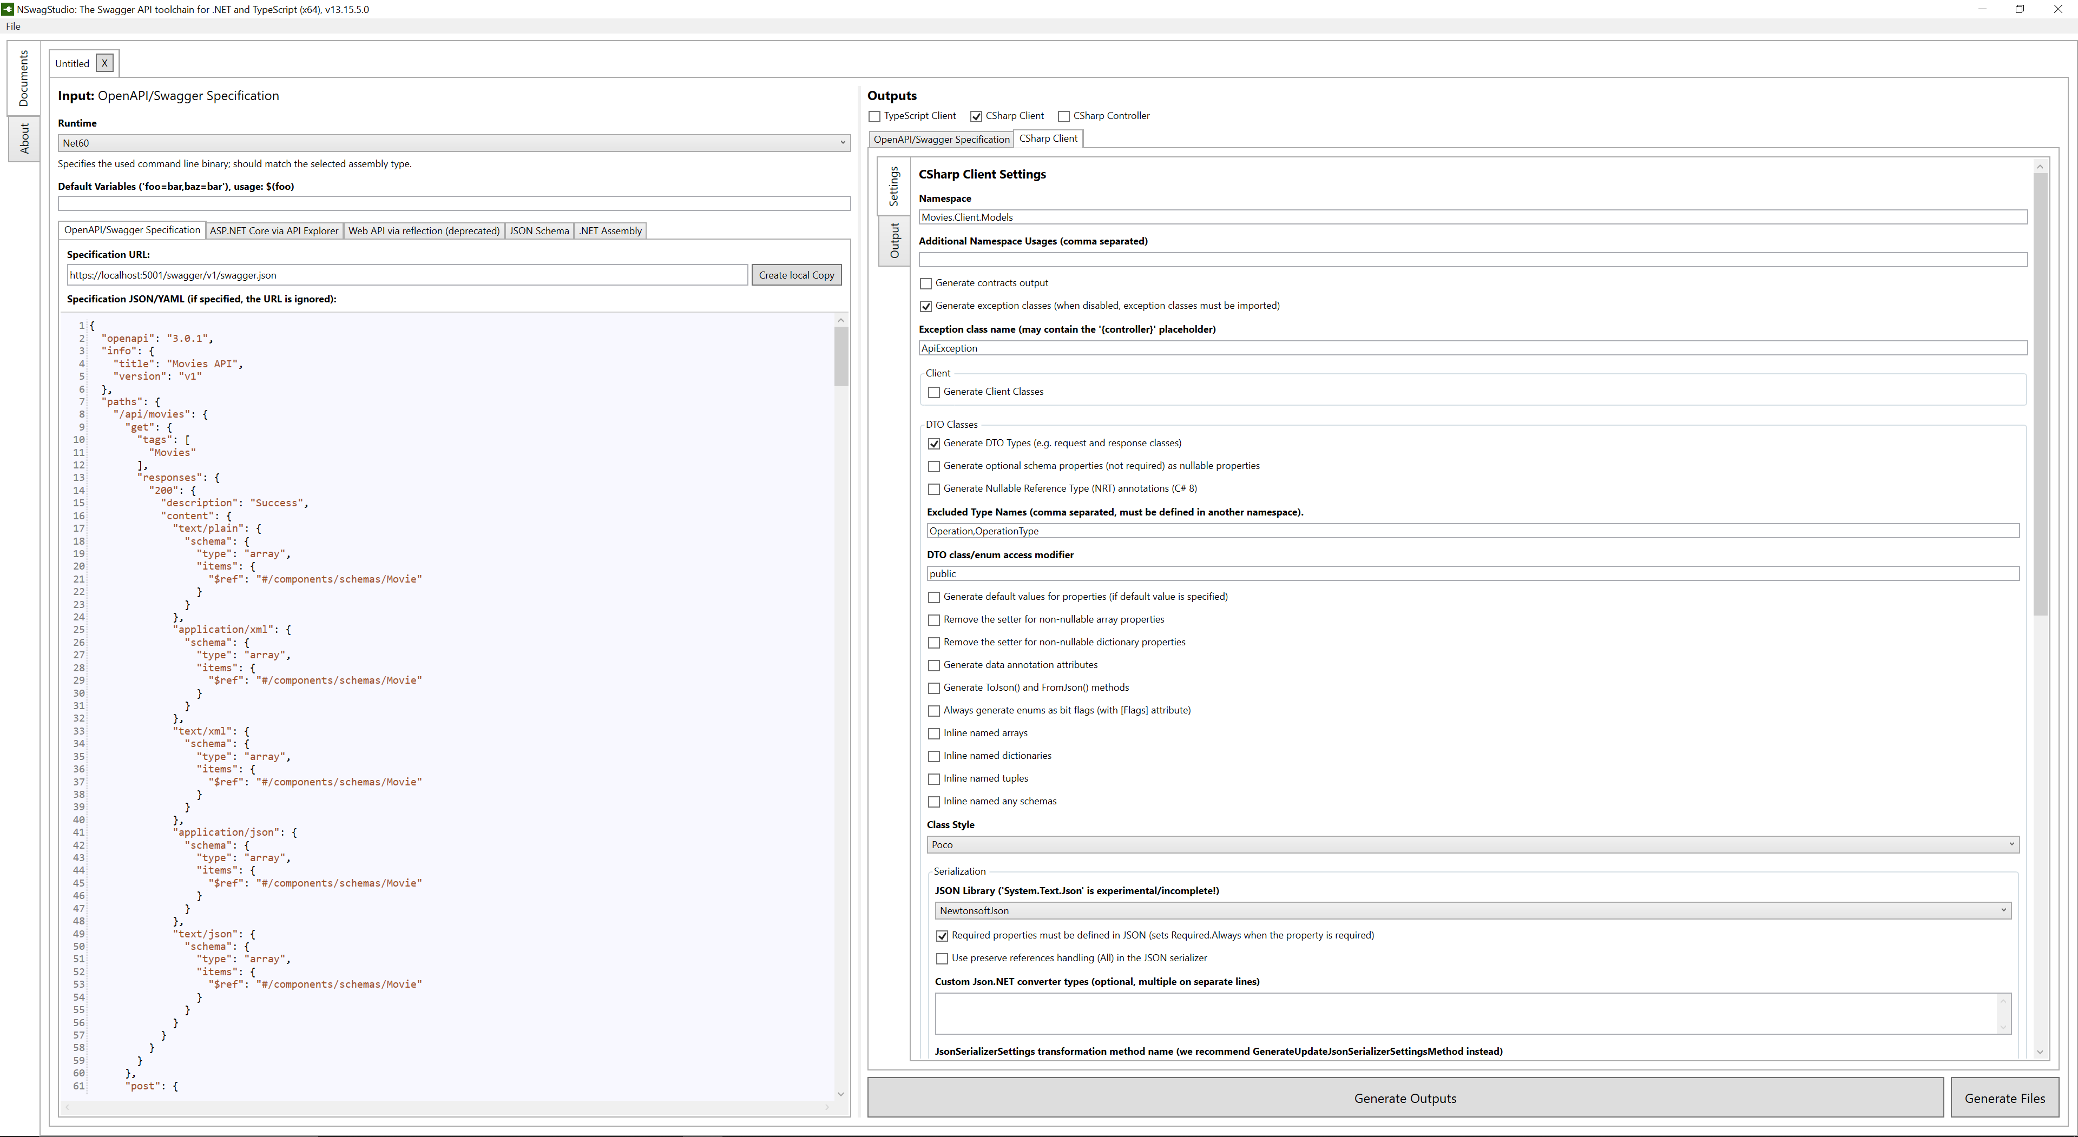
Nswag studio – 3 – exclude Operation, operation type

Slide 32
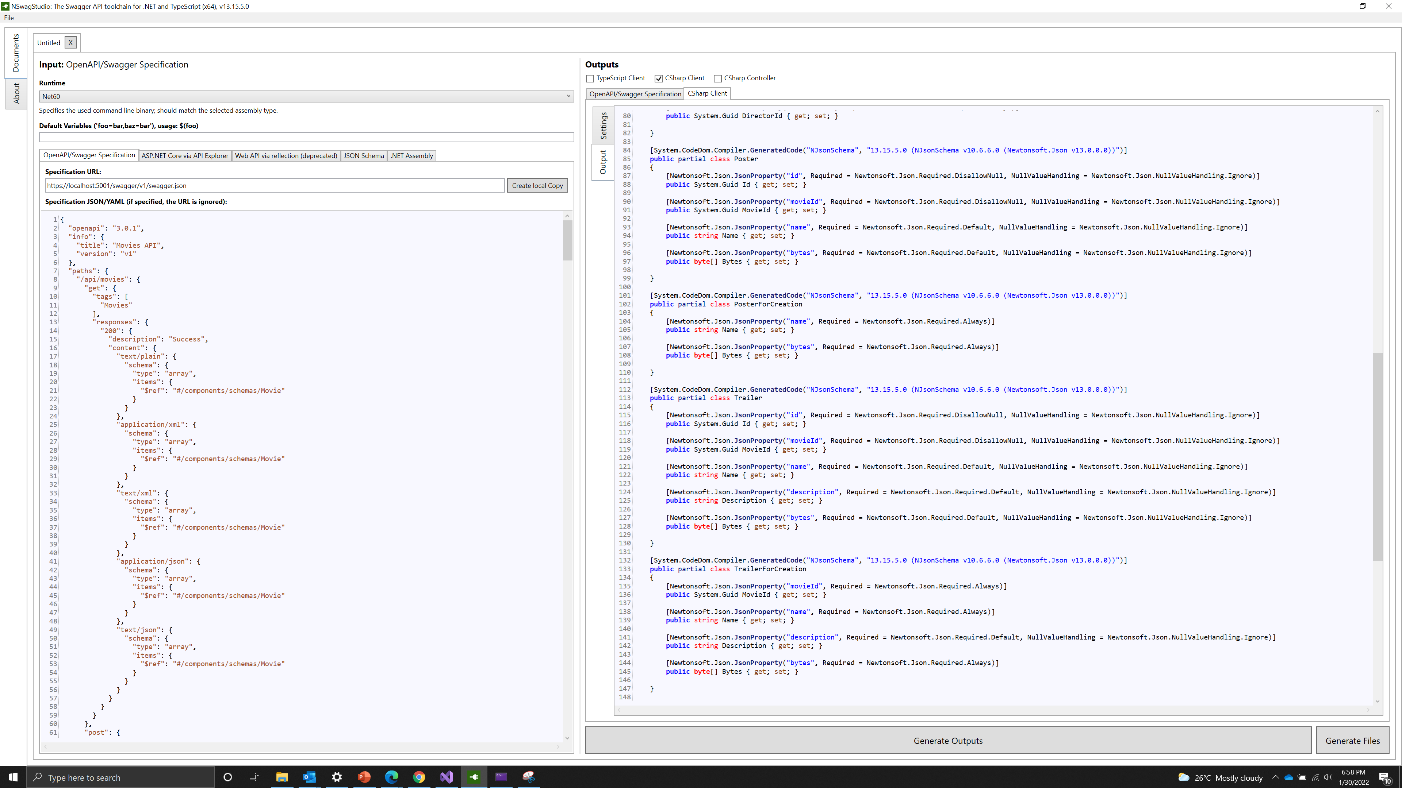
Nswag studio – 4 – generated dto models

Slide 33
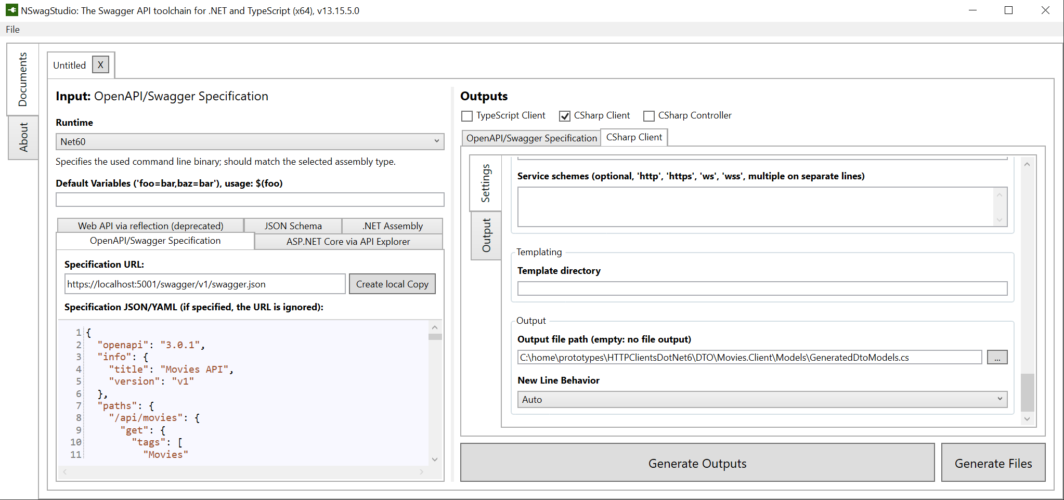
Nswag studio – 5 – set output path

Slide 34
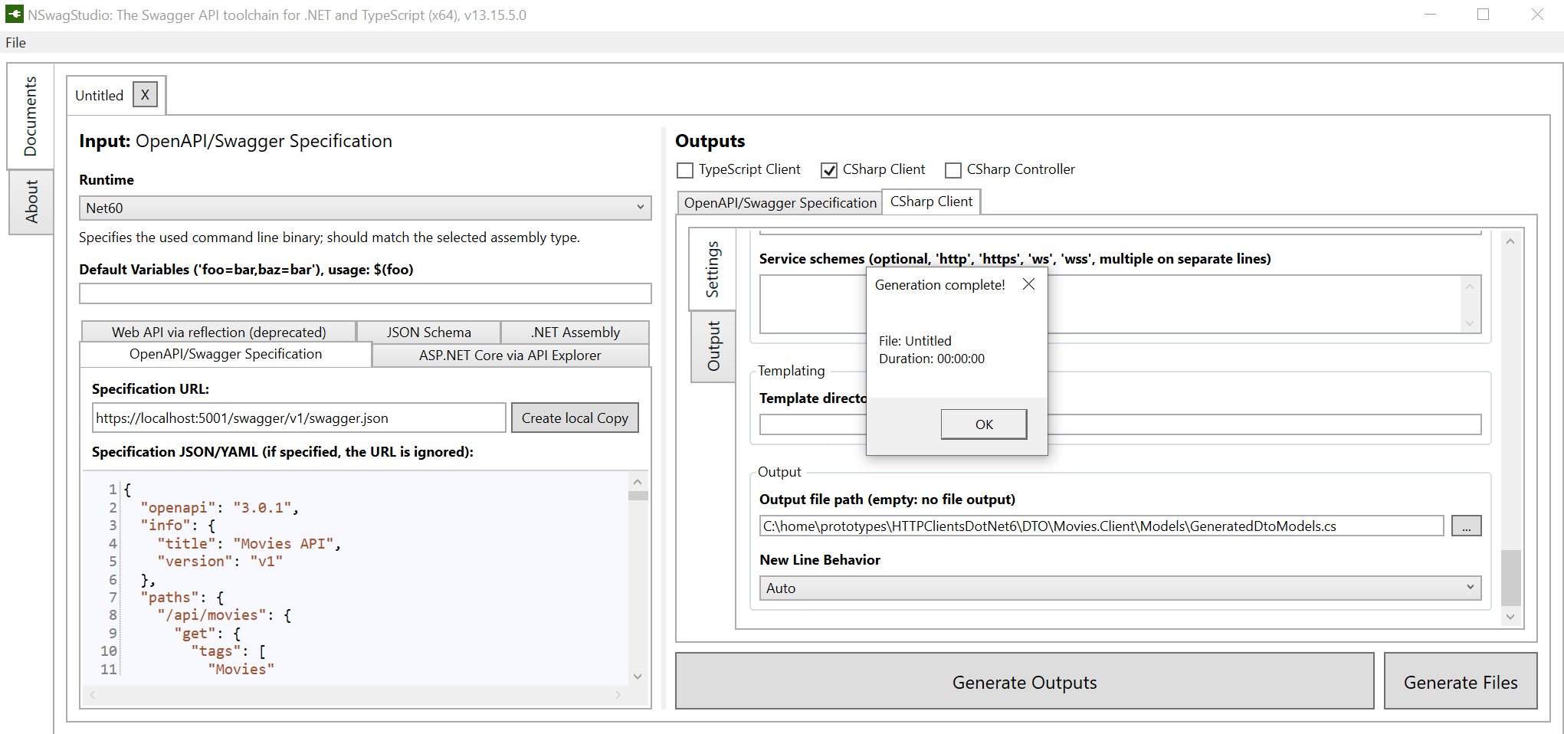
Nswag studio – 6 – generate files

Slide 35
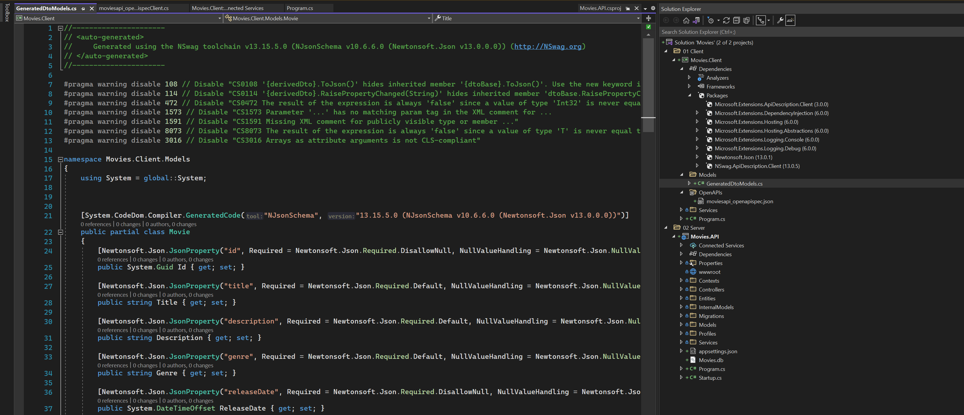
Nswag studio - 7

Slide 36
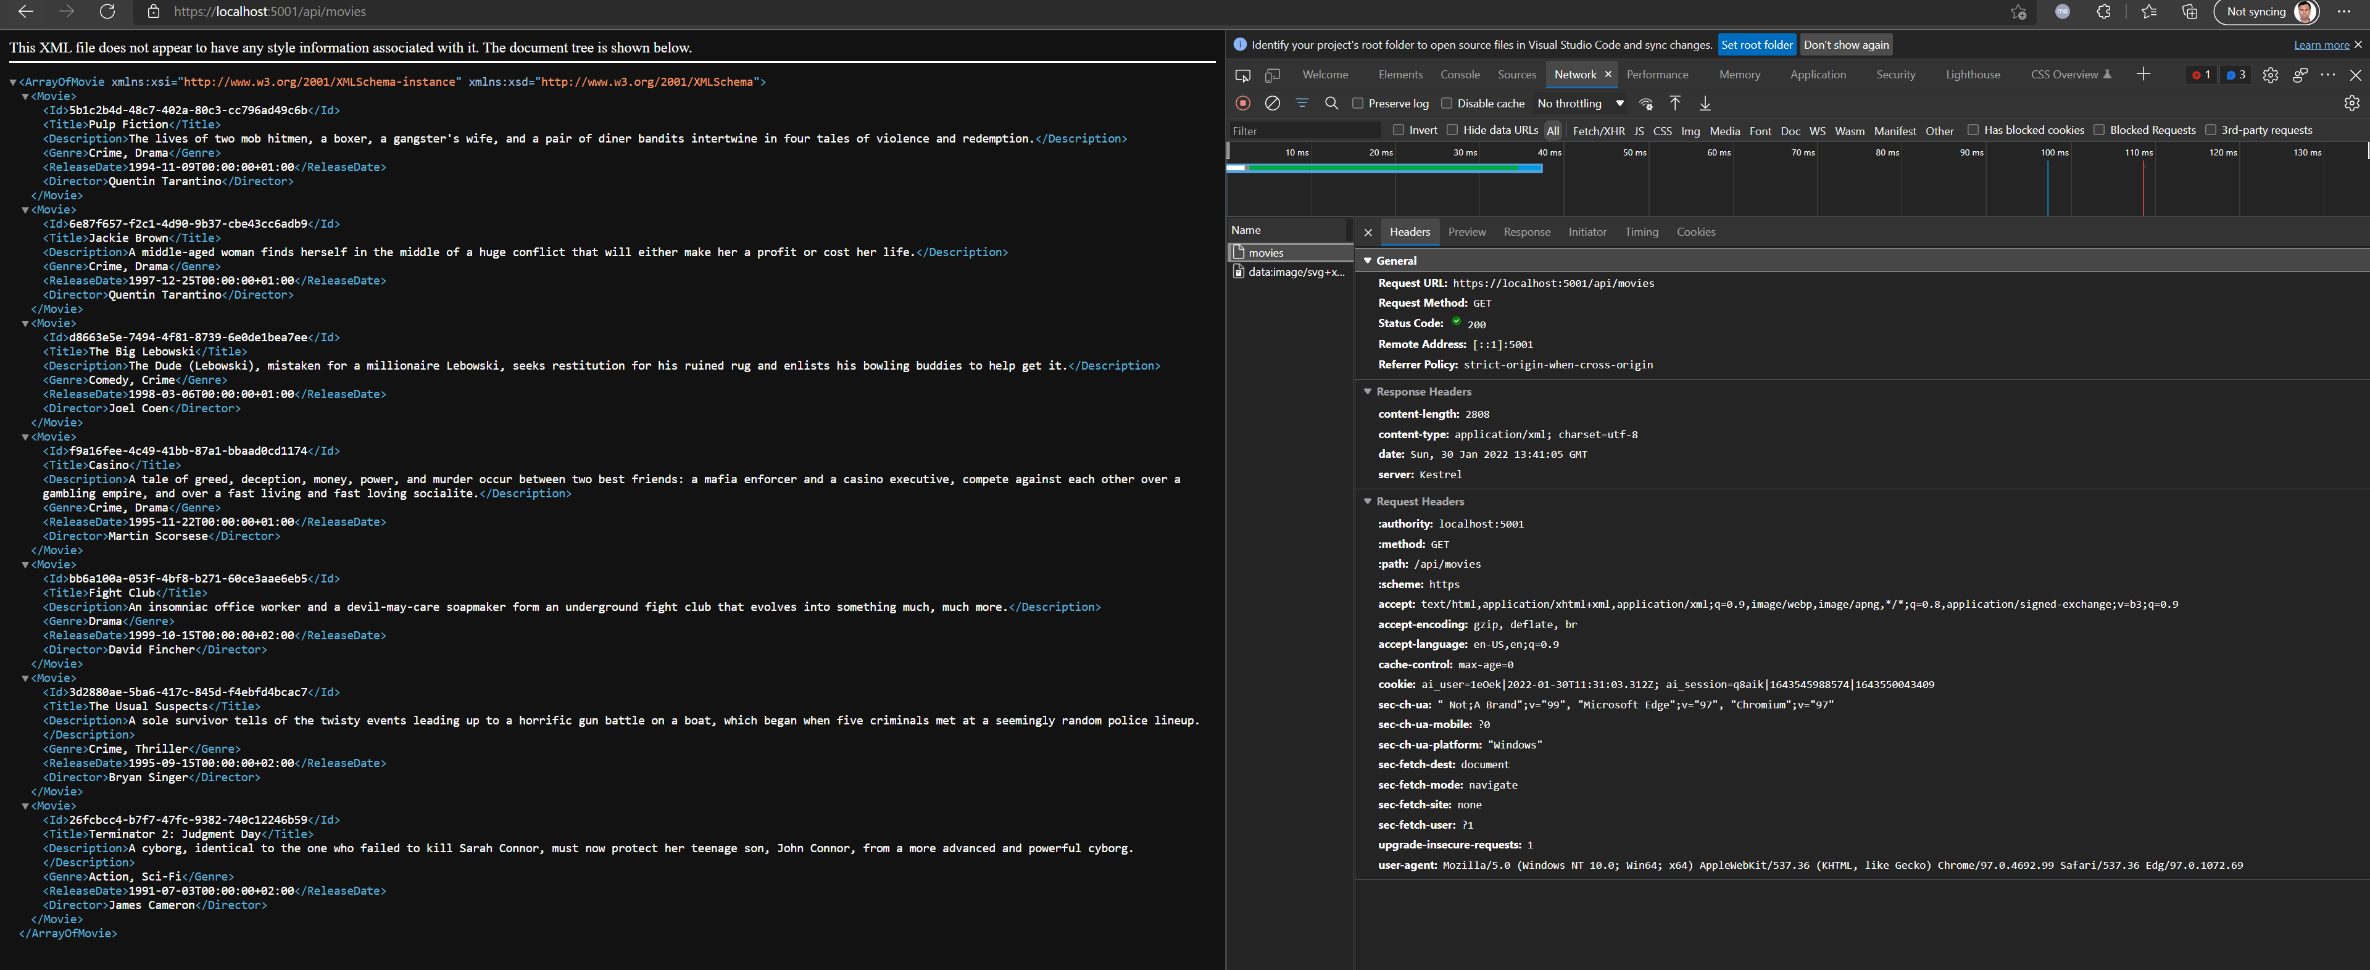
GET MOVIES – browser default requests xml

